Slide 1
Togo
BY BRYONY, JAMES R, SHYLAH AND TILLY

Slide 2
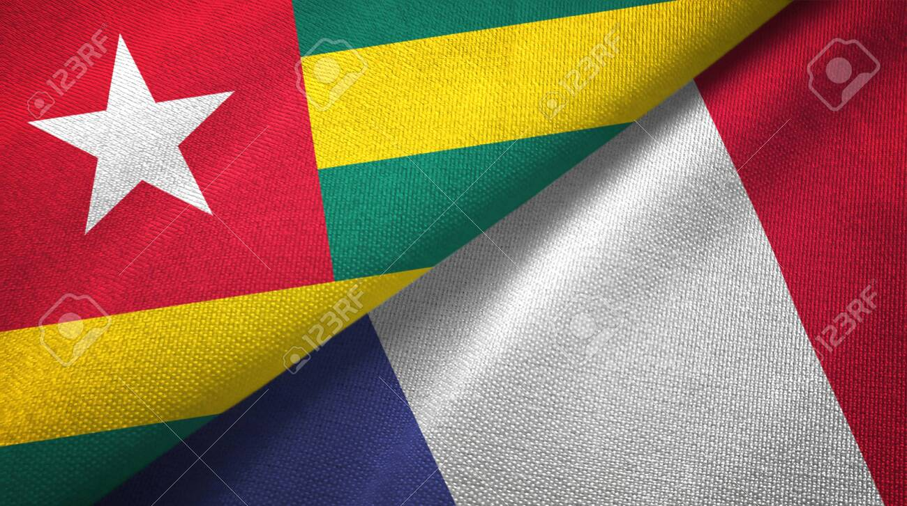
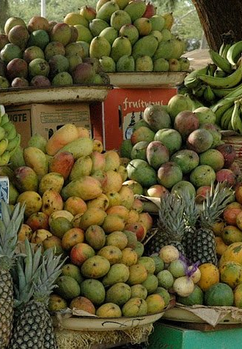
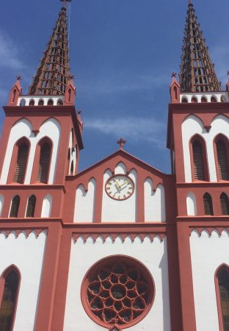
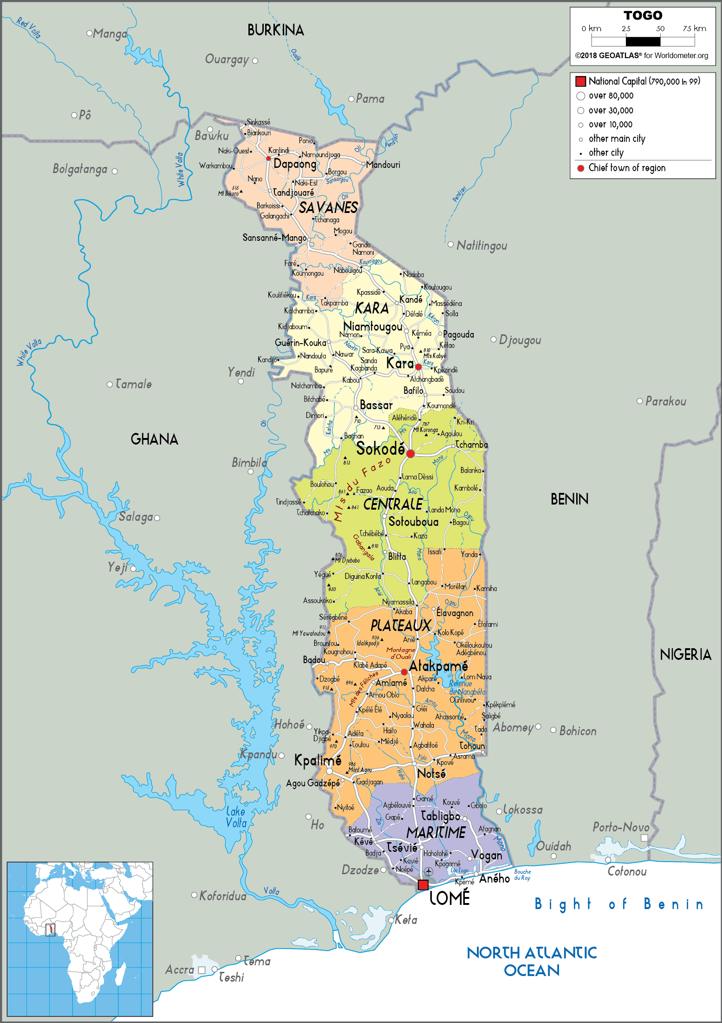
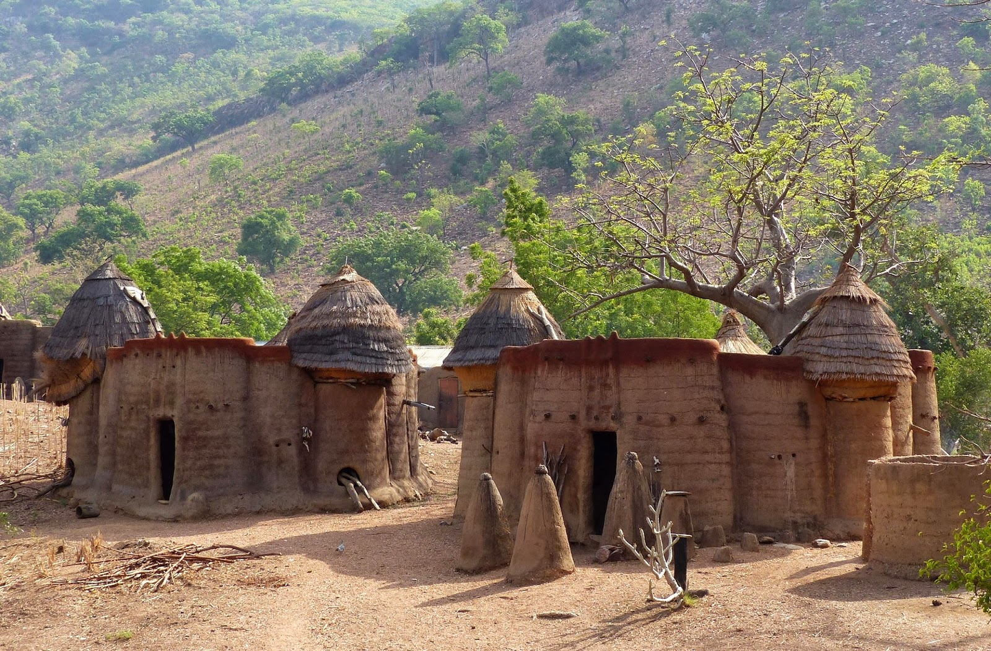
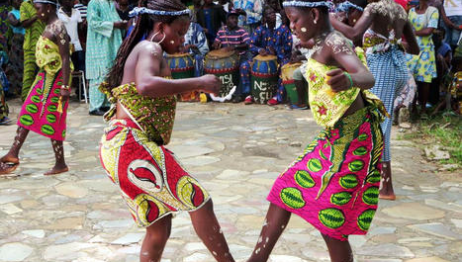
TOGO

Slide 3
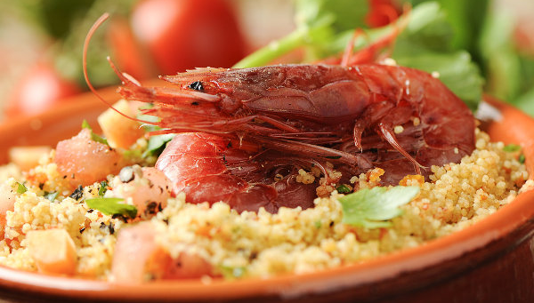
FOOD and SPORTS
MAIZE, RICE, MILLET, CASSAVA, YAM, PLANTAIN AND BEANS ARE SOME OF THE MOST IMPORTANT FOODS IN Togolese CUSINE. Fish and bush meat are the most common sources of protein. Finally a traditional dish in Togo is called fufu. It is made from boiled yams which are mashed into a dough. It is served with a variety of sauces and side dishes.
THE MOST COMMON SPORT IN TOGO IS FOOTBALL. IT IS RUN BY THE TOGOLESE FOOTBALL FEDERATION. IN 2006, TOGO QUALIFIED FROR THE WORLD CUP. THEY ALSO ENJOYED BOXING. IN THE LATE 1990S ZAFROU BALLOQUO, A TOGOLESE MIDDLEWEIGHT, WAS RANKED IN THE WORLD'S TOP 10.

Slide 4
tourism
Togo is known for many things including its history, attraction sites, culture and commercial activities. Tourist can visit:
The grand marche
The Lomé cathédrale
Monument of l’indépendance
The National muséum
the palais de congres
THERE ARE ALSO BREATHTAKING VIEWS FROM MOUNT AGOU WITH ITS NEAR 1000M PEAK. IT IS THE HIGHEST MOUNTAIN IN TOGO. TOURISTS CAN ALSO VISIT A UNESCO HERITAGE SITE. KOUTAMMAKOU IS HOME TO THE BATAMMARIBA OF TOGO, A TRIBE KNOWN FOR ITS MUD TOWER-HOUSES.

Slide 5
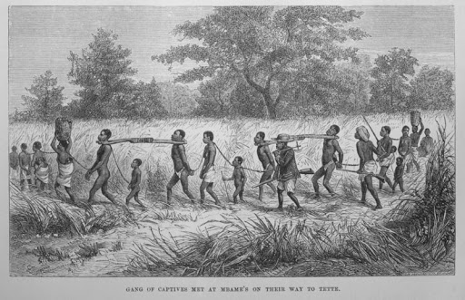
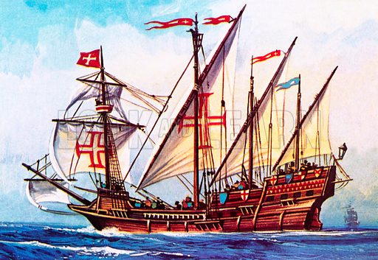
history
Togo gained its independence from France in 1960
Until the 19th century, togo was a major slave trade center
The first Europeans to Discover Togo were João de Santarém and Pêro Escobar, the Portuguese explorers who sailed along its coast between 1471 and 1473

Slide 6
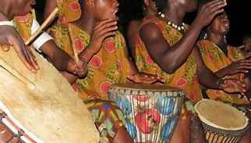
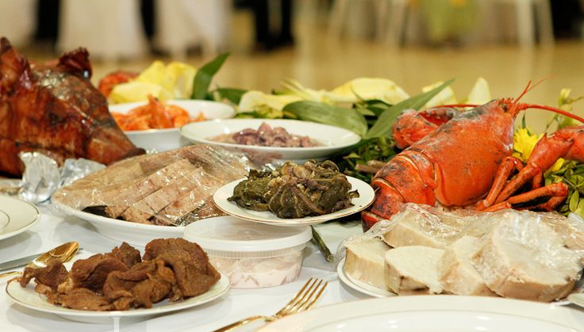
Traditions
Music is essentially dedicated to celebrating the bravery and strength of the initiated.
Several accessories and percussion instruments are used in traditional Togolese music. made of wood, metal, animal skins and animal horns.
Togolese dances include kamou, soo, tchimou, the southern royal djokoto.
Traditional Tongan Food is made up of foods from the land and the sea. Tongan people are hunter and gatherers of land and sea.

Slide 7
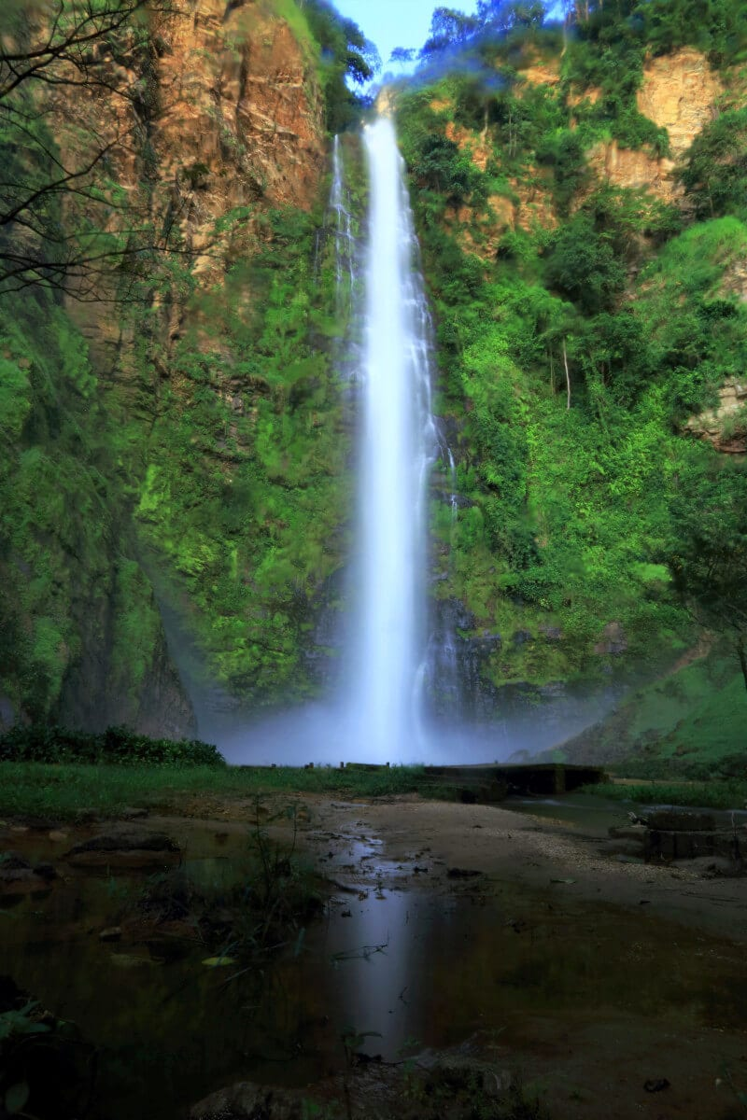
Geographical location
Togo is situated on the west African coast
It shares a border with both Ghana and Benin
Togo is mainly made up of savannahs but has a few tropical rainforests

