Slide 1
Switzerland
By Gemma, Chris, Lily and Stewart

Slide 2
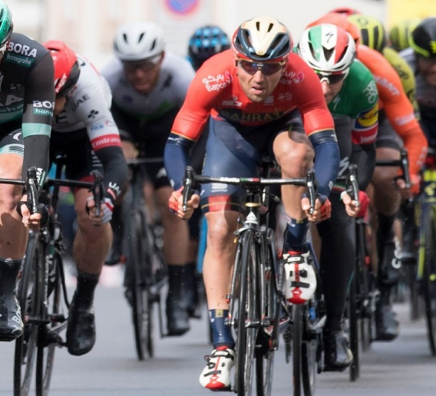
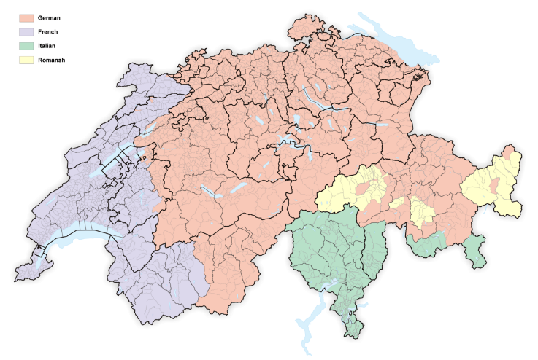
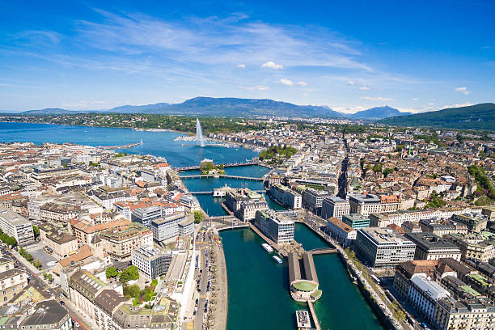
The Romandie region
The Romandie region is the french speaking region of Switzerland. The capital of the region is Geneva, the second most populated city with the first place being taken by the very famous Zurich. Romandie has 2.1 million people living there which is 25.1% of the Swiss population. There is often lots of competition between Zurich and Geneva on where people should go on holiday. Geneva is well know for being the business centre in Switzerland and for holding huge international conferences. Romandie is also well known for the ‘Tour de Romandie.’ A biking competition that happens yearly with the first tour being in 1947.

Slide 3
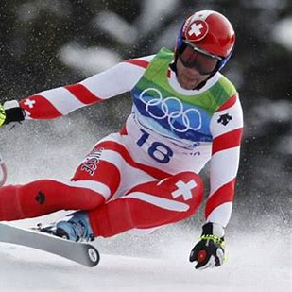
Sport in Switzerland

Slide 4
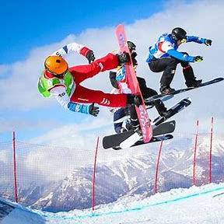
Winter sports
Switzerland excel at many winter sports they won 15 medals at the last Olympics they do well at skiing, this can be freestyle skiing or cross-country skiing.
They won 5 gold 6 silver and 4 bronze medals making them come 7th

Slide 5
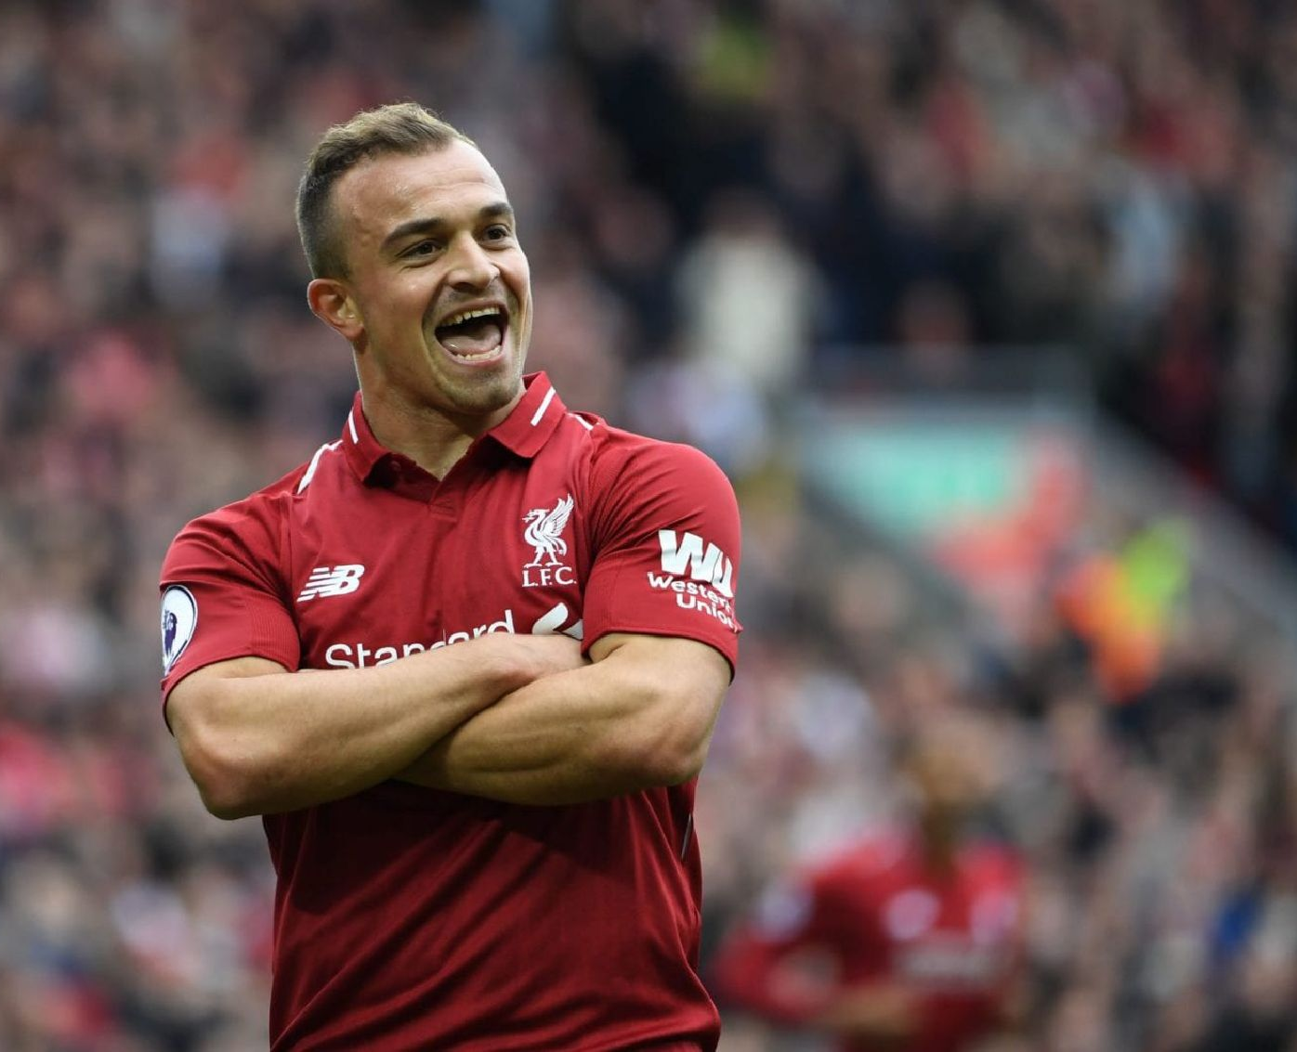
Summer sports
Switzerland are good at outdoor sports like skydiving and rafting. Switzerland also excel at football they have produced some world class players

Slide 6
Football in Switzerland
Switzerland competed at the last world cup. Some of their best player are Granit Xhaka who plays for arsenal , Zakaria who plays in the German league and Xherdan Shaqiri who plays for Liverpool . Switzerland also have a league of their own. In 1954 they got to the quarter finals of the world cup
https://www.youtube.com/watch?v=NAhJor6C4ik

Slide 7
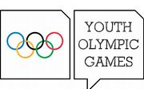
Lausanne youth Olympics
This was the youth winter Olympics which was set to be in the Romandie region in Switzerland it is an international multi-sport event which has only been held 3 times it has 1872 athletes, 79 countries and has 81 events

Slide 8
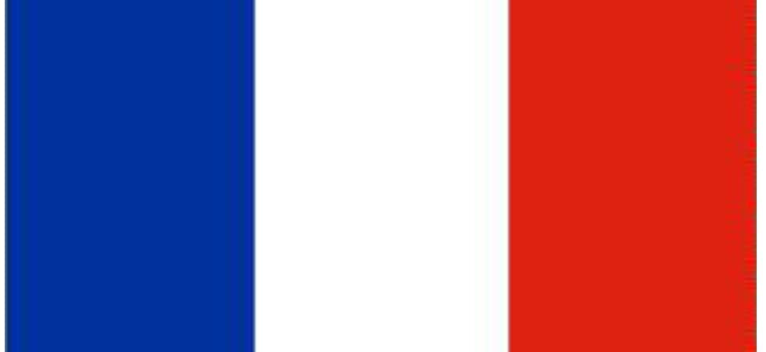
The difference in language
While the french spoken in Switzerland is almost exactly like the french in France there are some differences such as:
Some words are spoken differently or have different meanings
The accents can be quite different
And the expression on certain vowels often differs
An example of these differences is in the term breakfast – in France ‘petite-déjeuner’ is most commonly used however in Switzerland ‘souper’ is most commonly used.
There is also small changes in dialect depending on which town you are in.

Slide 9
Tourism in Romandie

Slide 10
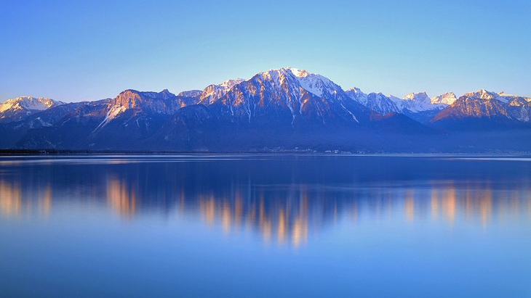
Lake Geneva
Lake Geneva is undoubtedly one of the most magnificent places you can go and see in the Romandie area

Slide 11
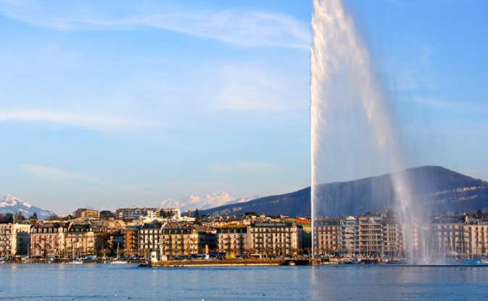
Jet d'Eau
This is one of the world's highest water jets. A powerful pump propels the water at a rate of about 500 liters a second, which accounts for the height it reaches:145 meters

Slide 12
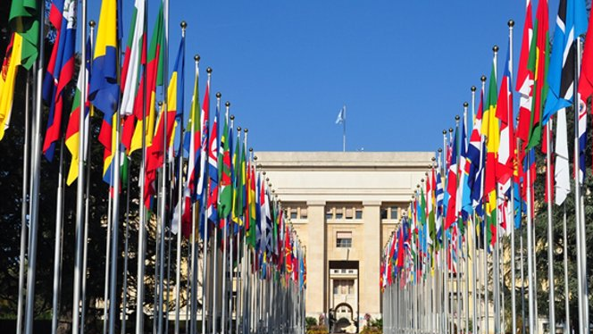
Palais des Nations
This large complex of buildings that make up the Palais des Nations is the European headquarters of the United Nations. Because of this it has become a center of world diplomacy, the largest UN center after New York, with upwards of 25,000 delegates passing through annually. If you go there you can see you the artworks and interiors donated by countries all over the world.

Slide 13
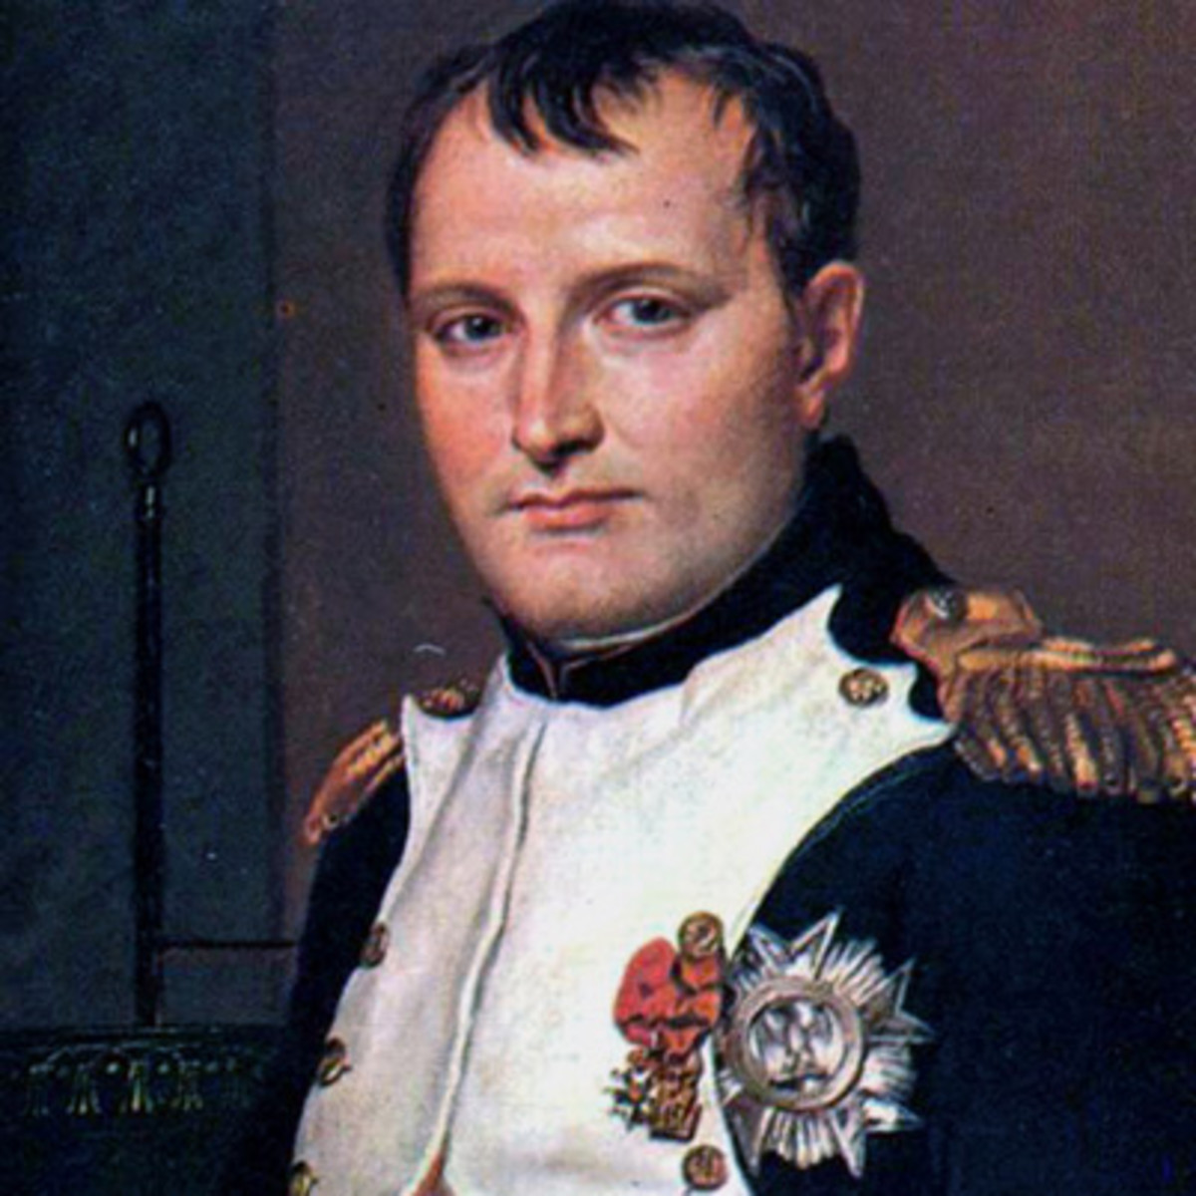
History of French in Switzerland
The early history of the Romandie region is tied to alpine culture. In the wake of the French Revolution Switzerland became victim to an invasion from the french which ended on the 17th of may 1798… however before this it was inhabited by the Helvetii ( a Celtic tribe ) because of all this Switzerland became a French client state meaning it was a republic that was formed because of the napoleonic wars. This invasion could be the reason why French is spoken in Switzerland.

Slide 14
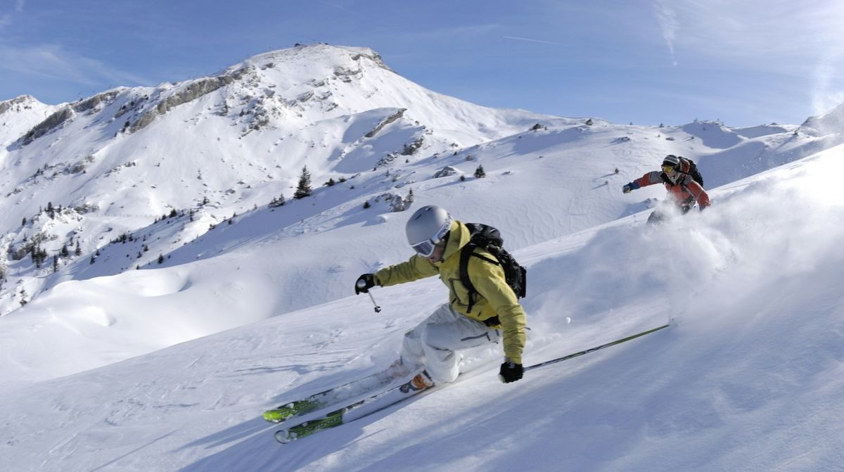
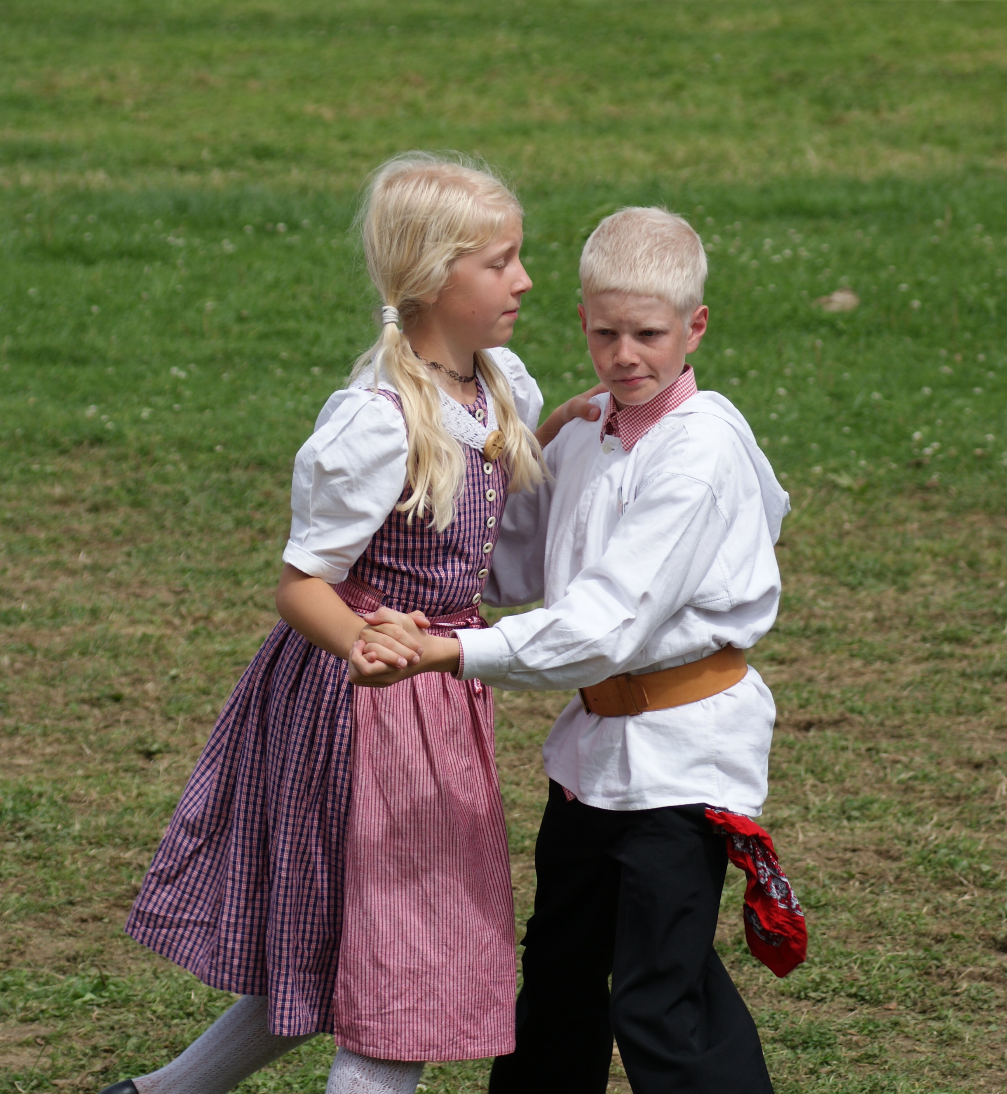
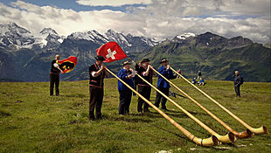
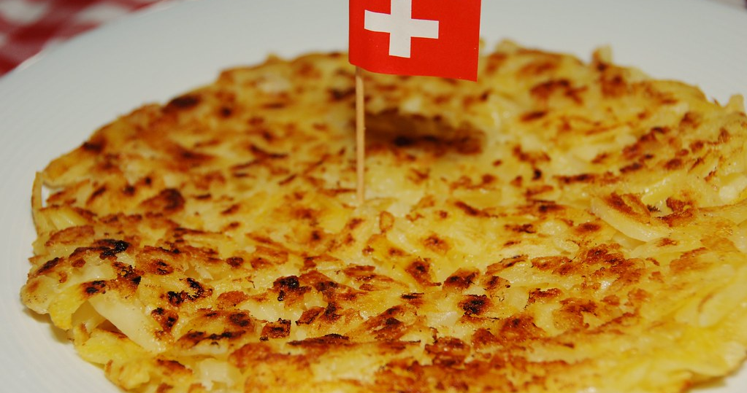
SWISS Culture

Slide 15
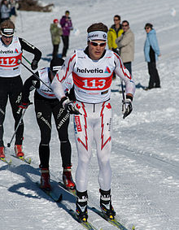
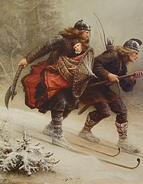
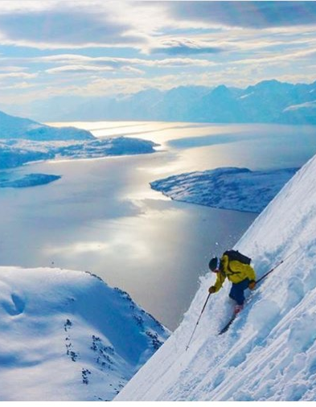
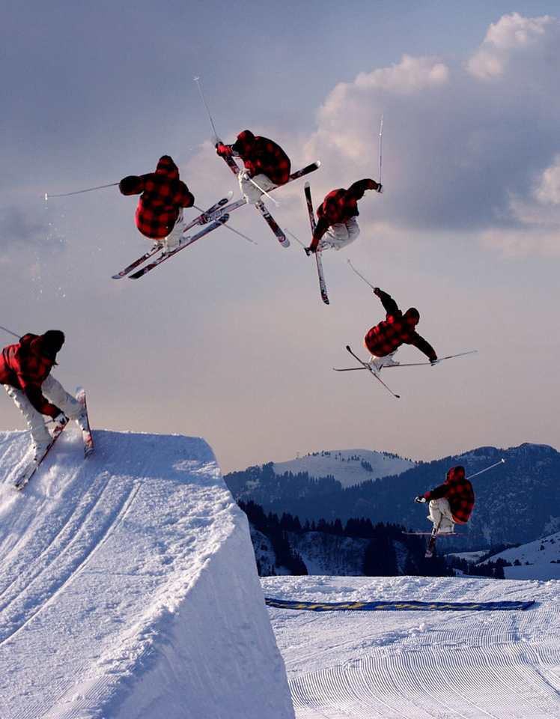
Skiing
Due to Switzerland's geography, skiing is a tradition which goes back generations. Snow in the Swiss Alps usually begins to fall in around September to October, with the skiing season beginning at the end of November and ends in April. However, the resort of Zermatt is open to skiers all year round, meaning that you can ski in the summer months.

Slide 16
Yodelling
Yodelling is a form of traditional Swiss folk music. Yodelling is a traditional form of singing that involves fast and frequent changes in pitch. Yodelling was originally used in the central alps by herders calling to their stock or to communicate between Alpine villages

Slide 17
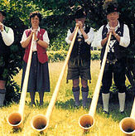
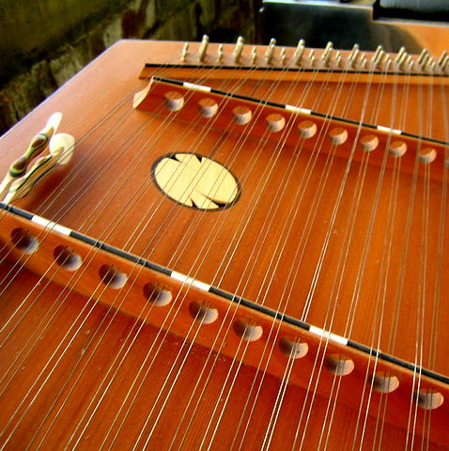
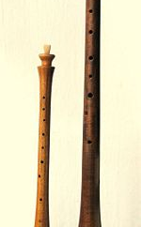
Other traditional music
Traditionally used instruments include; the alphorn, the hammered dulcimer and the shawm.

Slide 18
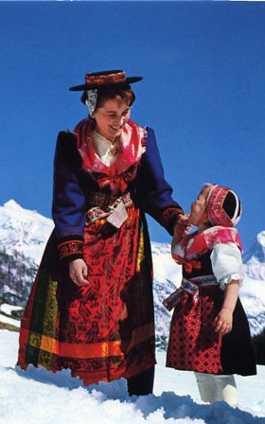
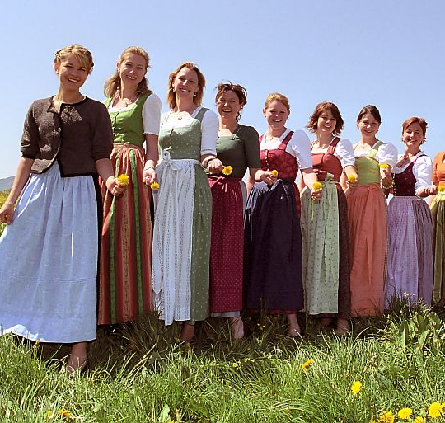
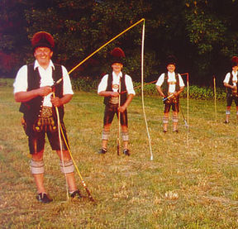
Traditional dress
The traditional costume for women and girls is long-sleeved jackets, silk aprons and straw with ribbons dangling from the brim. Gold lace caps are also a traditional female costume. For men, the traditional clothing is traditional leather shorts, called lederhosen with leather boots.

Slide 19
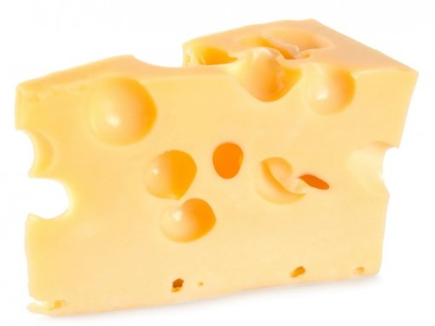
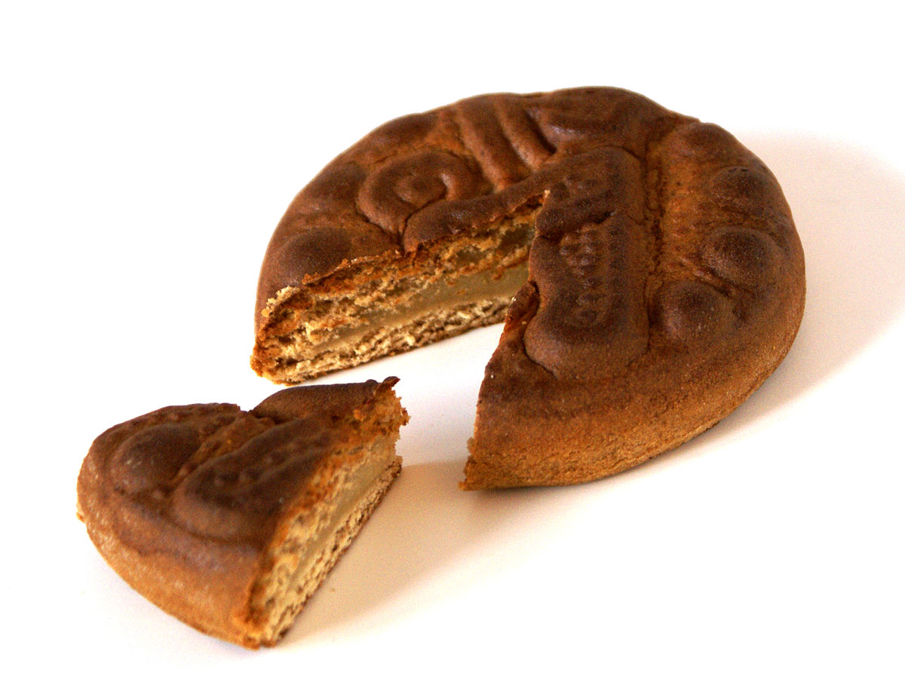
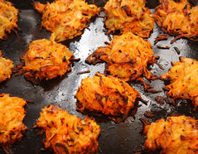
Swiss traditional food
Switzerland is very well known for foods such as cheese and chocolate. Other traditional foods include Rosti and Biberli.

Slide 20
Thanks for listening
Are there any questions?

