Slide 1
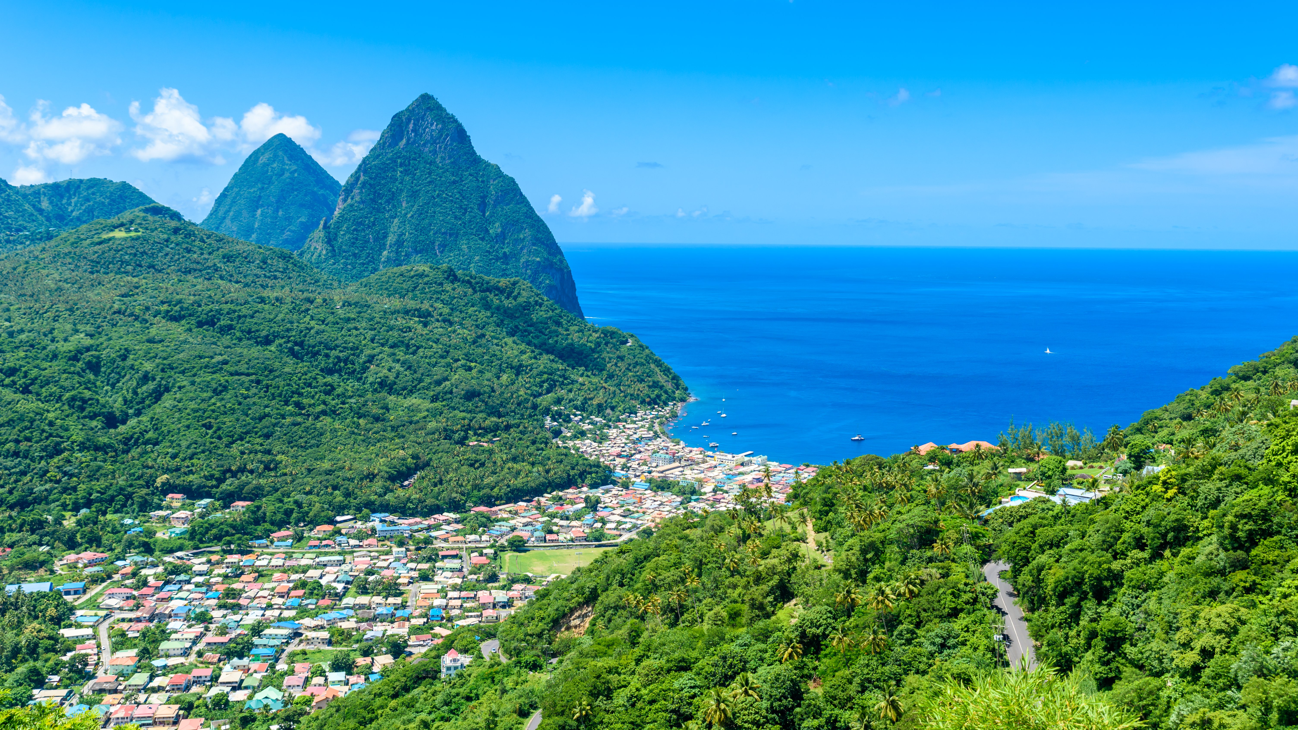
St Lucia

Slide 2
This presentation will include;
Geographical information
History ( why French is spoken)
Tourist information ( what there is to do)
Culture and traditions ( food, sport, music and languages)

Slide 3
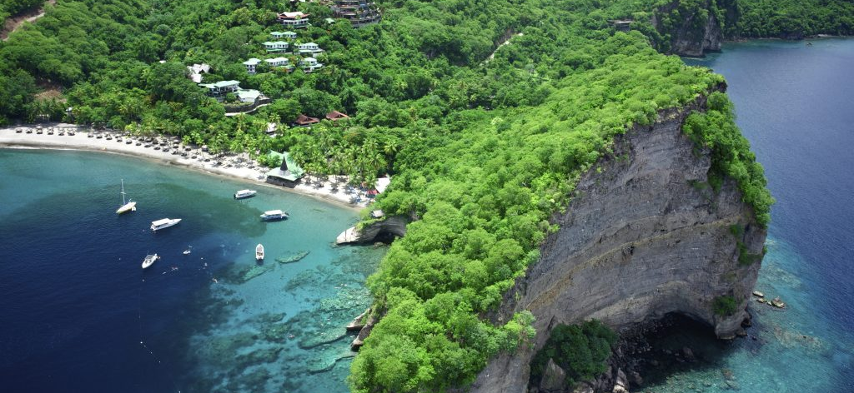
GEOGRAPHICAL INFORMATION
Saint Lucia is an Eastern Caribbean island nation with dramatically tapered mountains, the Pitons. Its coast is home to volcanic beaches, reef-diving sites and fishing villages, The capital, Castries, is a popular cruise port.
POPULATION: 178,844
St Lucia is a small island – 43 kilometres long and a maximum of 23 kilometres wide but its landscape is very varied.
This is the flag of Saint Lucia —→

Slide 4
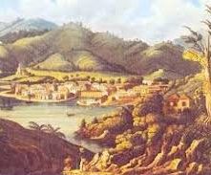
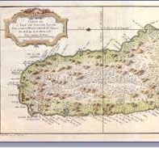
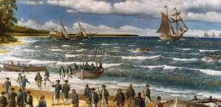
History of St Lucia
Saint Lucia was first called “Louanalao”.
The French took control of the island in 1744, and by 1745, the island had a population of 3455.
After the French bought St Lucia in 1651, war broke out between the French and English, which lasted until 1814.

Slide 5
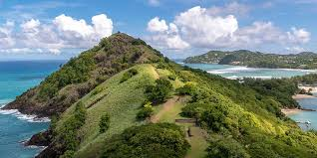
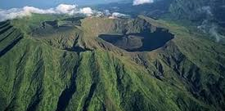
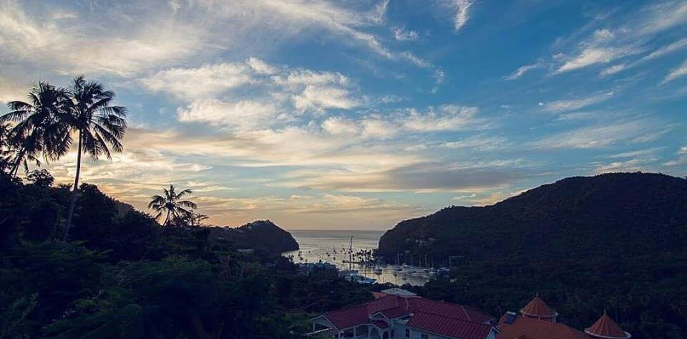
Iconic Landmarks of St Lucia
Pigeon Isle
Soufrière Volcano
The Pitons
Marigot Bay

Slide 6
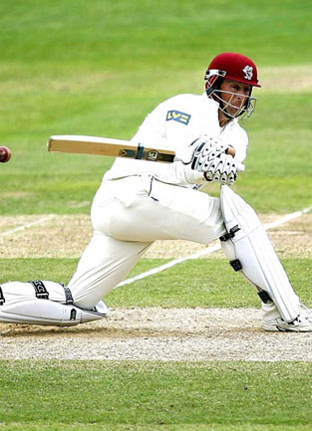
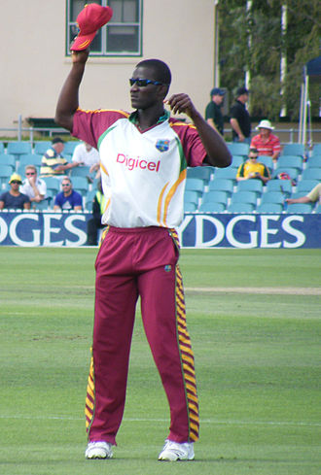
Languages and Sport
The official language is English although they also speak French and different Indigenous languages.
Cricket and football are the most common sports.
In 2004 Daren Sammy made history as the first and only St Lucian to be called up to the West Indies cricket team. He then went on to win two T20 world cups as captain.
Nadine George is another of St Lucia's leading cricketers. She was the first West Indies woman to hit a century in Test cricket and was eventually named captain of the West Indies team.

Slide 7
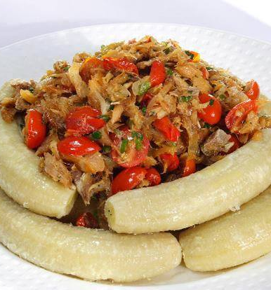
St Lucian Food
St Lucian food is mostly a combination of British, French and Indian cuisine.
It's national food is green bananas and salt fish, as you can see on the right.

Slide 8
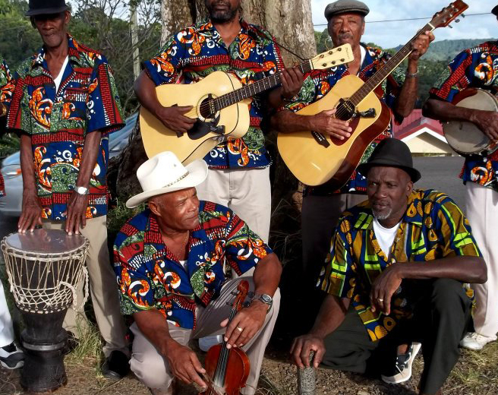
Music
The music in St lucia is mainly inspired by African traditional music.
They play instruments such as the cuatro and a four stringed banjo called the bwa poye.

Slide 9
Tourist Information
When you are in St Lucia there are loads of things to do, such as:
Visit the Gros Islet street party
Visit the sulphur springs

Slide 10
Gros islet street party
The Gros islet street party is where the small fishing village of Gros Islet have a party every Friday night. There is loads of St Lucian street food, music and dancing there.

Slide 11
Sulphur Springs
The Sulphur Springs Park is a world-renowned site where visitors from all over the world come to experience the black water pool baths and learn about the drive-in volcano's history by going on an all-day tour round them.

