Slide 1
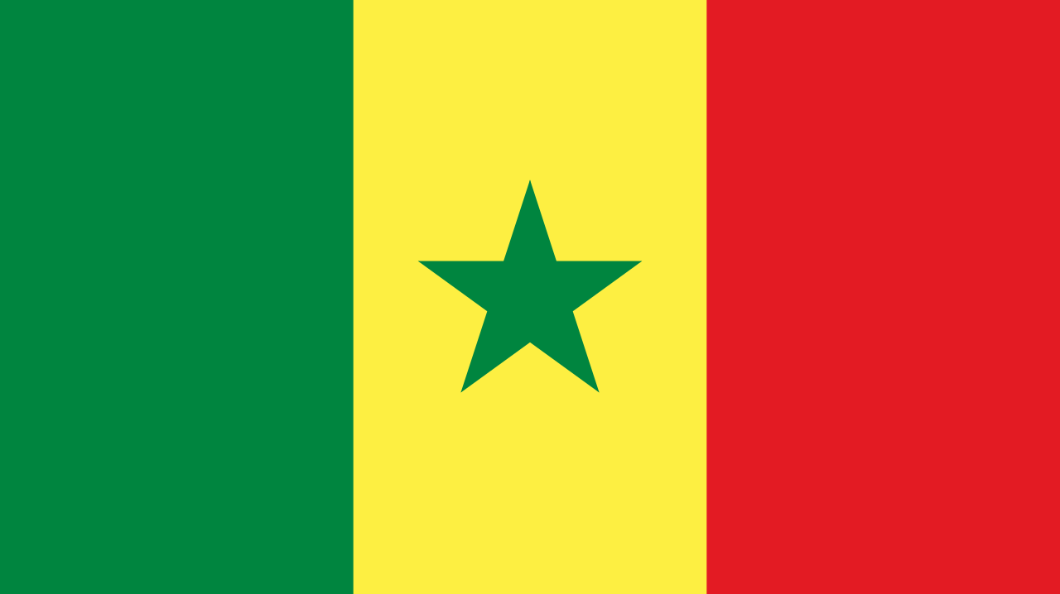
Senegal
By the boys and Paige

Slide 2
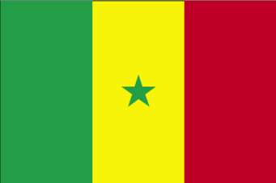
General Knowledge
The capital is Dakar
The population is 15,854,323
They speak predominantly French
The national anthem is Pinsez tous vos Koras, Frappez les Balafons. Which is French for Everyone strum your Koras, strike the Balafons
The flag of Senegal is...

Slide 3
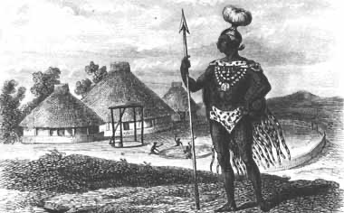
History
Archaeological findings indicate that Senegal was inhabited in prehistoric times and has been continuously occupied by various ethnic groups
1300-1900 close to one-third of the population was enslaved; typically as a result of captives taken in warfare
The British, French and Dutch fought for control of strategic points where slaves bound for the Americas could be collected
By the end of the 19th century the whole of Senegal was captured by the French
Therefore, Senegal inherited the French language during the colonial era

Slide 4
Culture
This is there National Anthem
The Toucouleur people, who were one of the first groups to settle in Senegal, converted to being Muslim in the 1000's, however they maintained many of the beliefs that they had followed in animism. The first French settlement was made at St Louis in 1659.
The statue on the right is the African Renaissance Monument, which is the tallest monument in Africa.

Slide 5
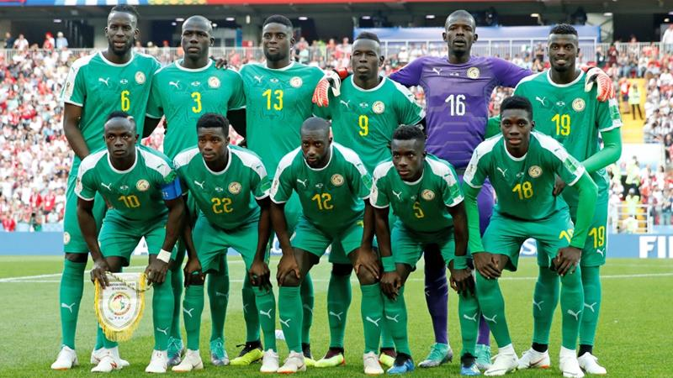
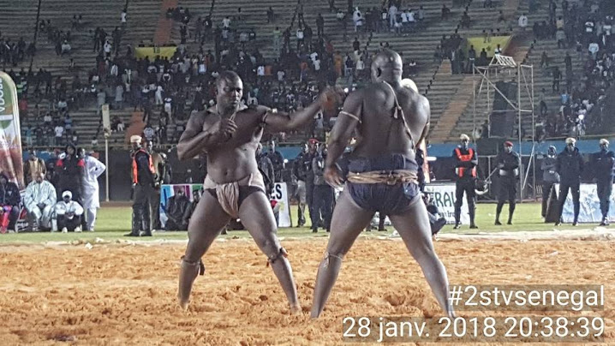
Sport
Wrestling and Football are the main national sports in Senegal,
The Senegal citizens do not class wrestling as a sport meaning football is their number one.
They have some successful football players, Sadio Mane(Liverpool FC player) Kalidou Koulibaly(Napoli), El Hadji Diouf(Retired but formerly of Rangers and Liverpool)

Slide 6
Lake Retba
The lake is pink by Dunaliella Salina algae. It is also pink because of how much salt it has, which makes the colour pink.
The lake is very popular for fishing and people fish their 6-7 hours a day, everyday to provide for their family.

Slide 7
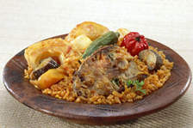
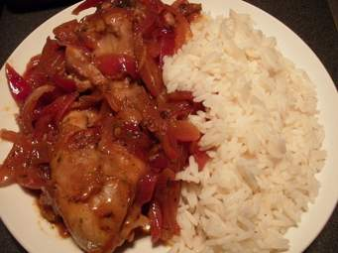
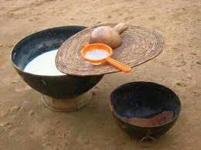
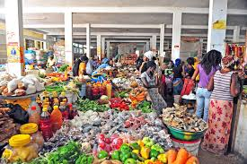
Food
The national dish of Senegal is Thiéboudienne, which consists of fish and rice.
Another dish which also invovles rice is Chicken Yassa. This is chicken marinated with lime juice, vinegar and onions.
A well known drink from Senegal is Toufam, which is a kind of yougurt mixed with sweetened water
Thieboudienne
Chicken Yassa
Toufam

Slide 8
Geographical location
The distance from France to Senegal is 2390 miles
Senegal is a coastal West African nation located 14 degrees north of the Equator and 14 degrees west of the Prime Meridian.
the highest point of Senegal is found southwest of Kedougou at 1,906 ft (581m)

Slide 9
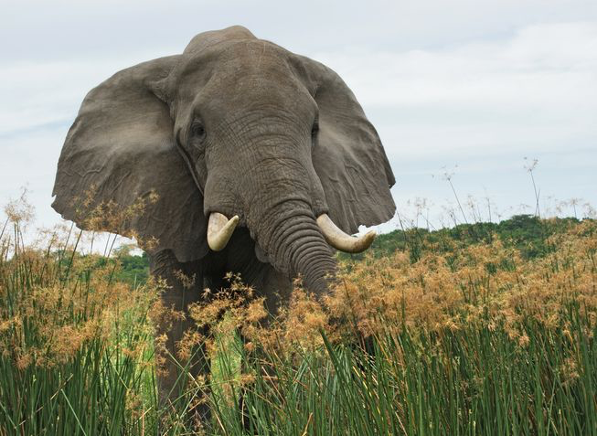
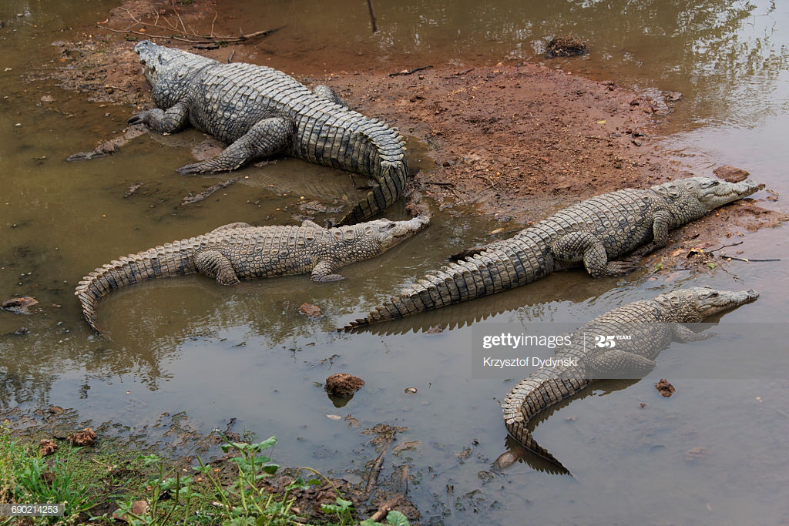
Animals and plant life
Plant life:
North:
Mix of shrubs
Tree savannas
South:
Savanna
Dry woodlands: acacia, baobab, mahogany, teak, mangrove, silk cotton trees and oil palms
Animals:
Some large mammals have disappeared from the West due to displacement by human settlement.
Niokolo Koba National Park:
Elephants
Antelopes
Lions
Panthers
Cheetahs
Jackals
Venomous snakes
Crocodiles
Hippopotamuses
Turtles
South West:
Hippopotamuses
Leopards
Crocodiles
Water buffalo

Slide 10
Thanks for listening
Stay safe x

