Slide 1
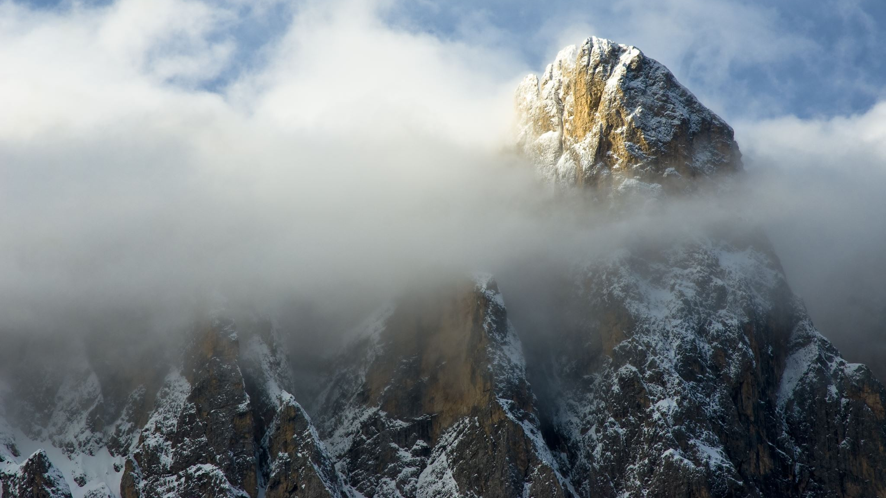
MONACO
By Mark, Olivia, Lois and Katerina

Slide 2
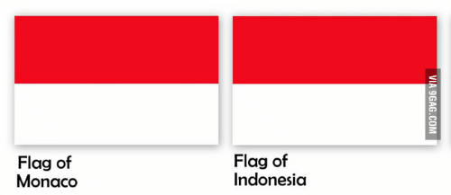
Interesting Facts
Monaco is the second smallest nation in the world
Although it hosts one of the most famous casinos in the world, the Monte Carlo Casino, citizens of Monaco are not allowed to enter it as gambling is illegal
The native Monégasques are a minority in their own Country
It is the most policed nation per population in the world with 1.4% of citizens being police officers

Slide 3
hello

Slide 4
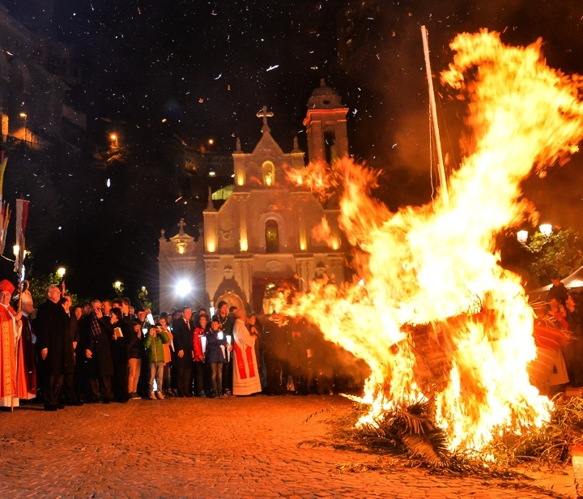
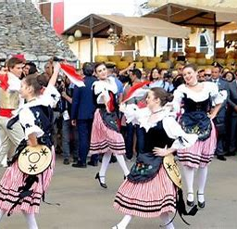
Culture
Monaco is characterized by ethnic groups such as French, Italian and Monegasque.
The church is a key part of Monaco's culture, with most of the population being Roman Catholic.
Their main rituals and ceremonies are the feast days of Saint Roman, Saint Blaise and Saint John, as well as Easter.
On 19th November, Monaco celebrates its independence day. This includes parades and special events in church.

Slide 5
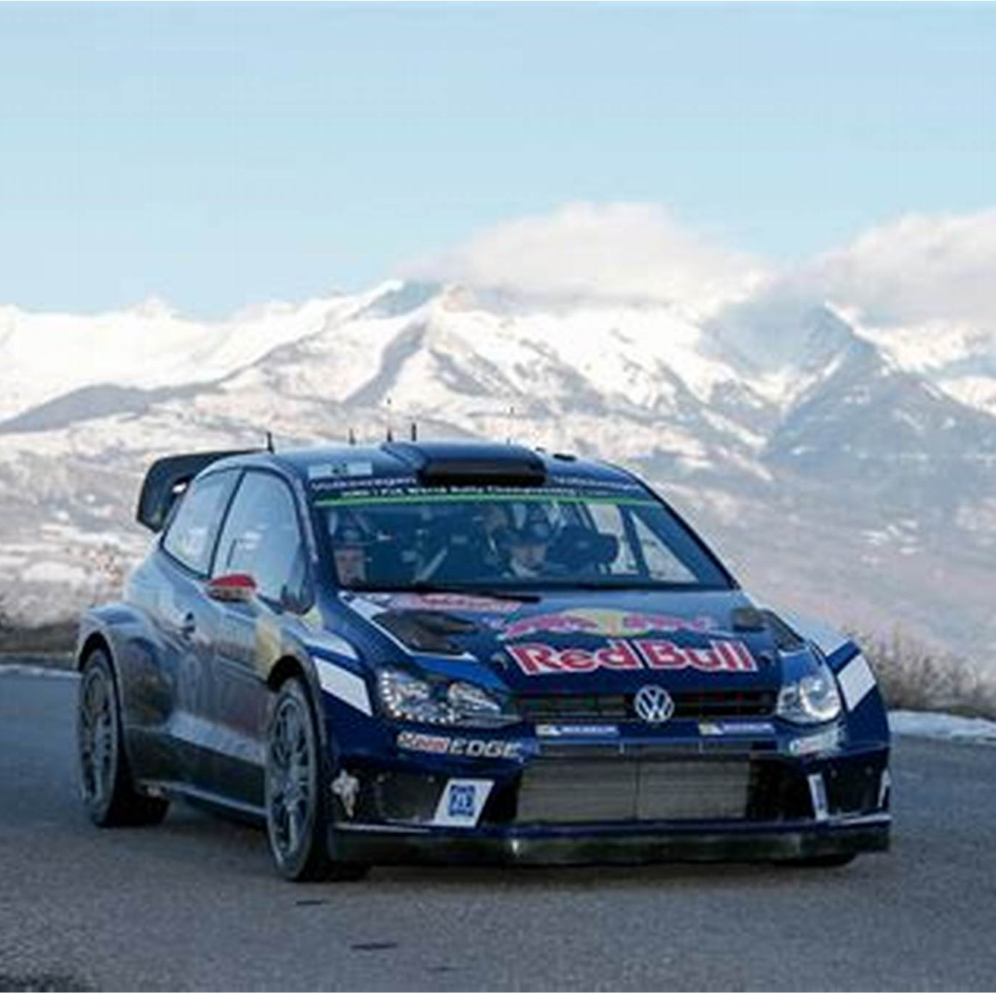
Food and Sport
Monaco's traditional foods include:
Gnocchi
Stocafi (fish stew)
Porchetta (stuffed pork)
Monaco is extremely well known for the Monaco Grand Prix, which is held every year on the last weekend of May. Monaco is also home to one of the hardest rallies in the world, the Monte Carlo Rally, which was originally held for Prince Albert I.

Slide 6
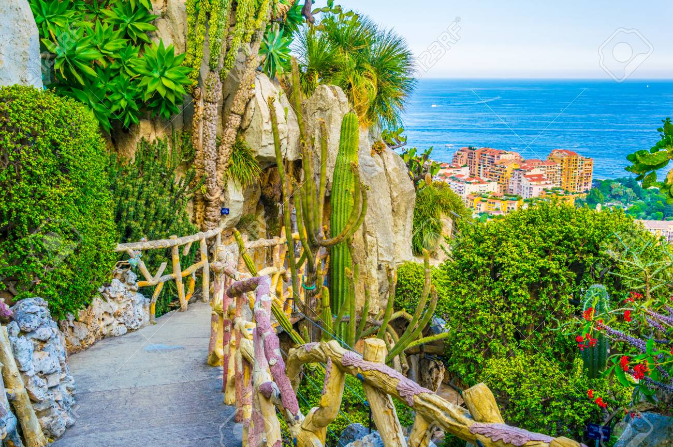
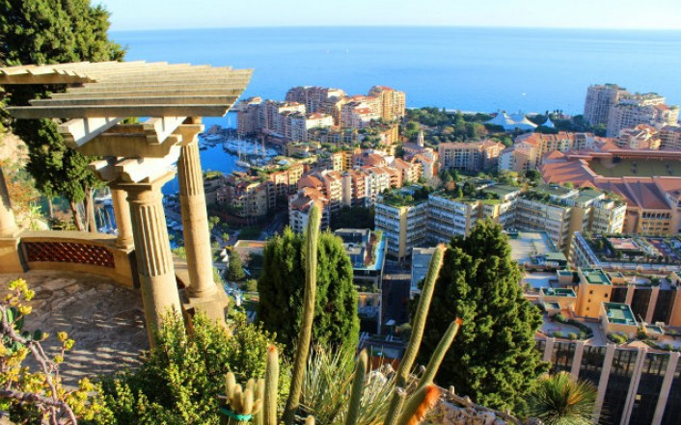
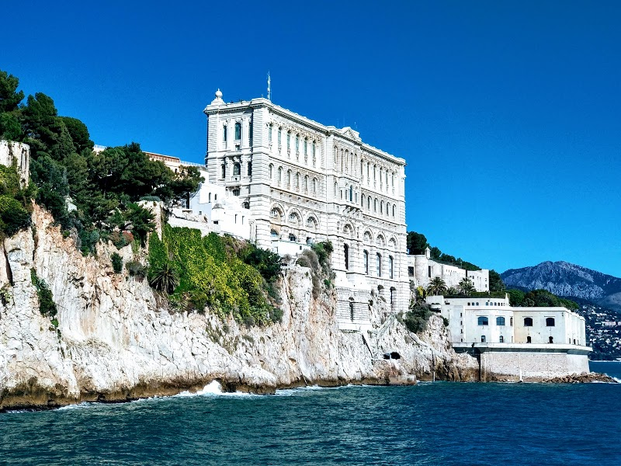
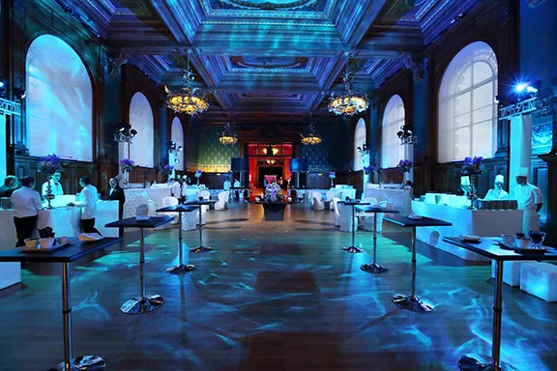
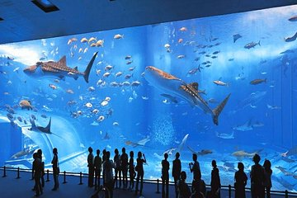
Tourist Information
Jardin Exotique - "The Exotic Garden" - in the Fontvielle area
(more modern section of Monaco)
A luxuriant place with tropical plants and flowers from around the world,
perched on a cliff overlooking the Mediterranean sea
The plants thrive on this hillside, because of its consistent warm, sunny climate
The location also has an Observatory Cave and an Anthropology Museum
Musée Oceanographique – "Oceanographic Museum" - in Le Rocher at 90 meters above sea level
One of the world's oldest aquariums with exhibits of marine science and oceanography, standing on massive foundations that took 11 years to build
Incredible aquariums containing rare species of fish and marine life with more than 6,000 specimens swimming in almost 100 pools, all reconstructed into a coral reef habitat

Slide 7
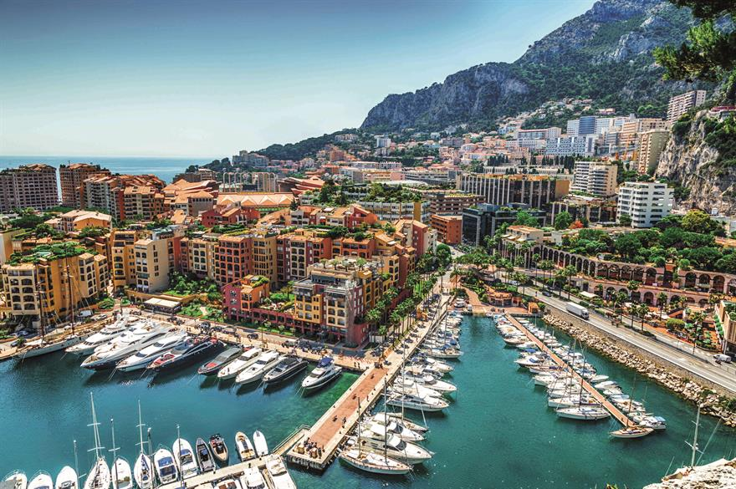
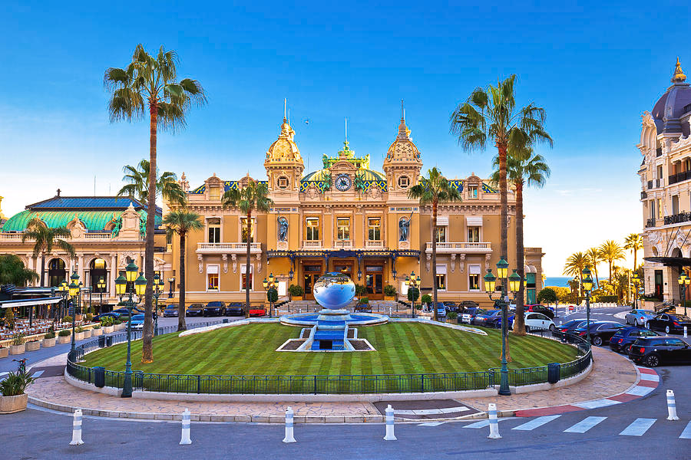
Tourist Information
Visit: Monte Carlo - "the district with the most glamorous atmosphere"
Monaco's wealthiest district stands on a rocky promontory to the north of the Port of Monaco
Breathtaking seaside views which can be seen from the terrace of Place du Casino
the world-famous gambling centre which has made Monte Carlo so famous
It is a great place for people-watching or to enjoy fine dining
Many fashionable shopping streets, like Avenue de la Costa (with luxury boutiques)

Slide 8
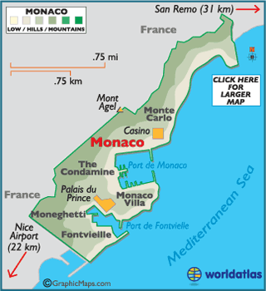
Geographical location
Monaco is the second smallest independent state in the world after the Vatican City with an area of 2.02km
France borders the country on 3 sides, with the other bordering the Mediterranean Sea.
It is a mountainous country as the land borders back onto the French Alps.
It is about 9.3 miles from the state border with Italy.
It also has the world's shortest coastline at 2.38 miles.

Slide 9
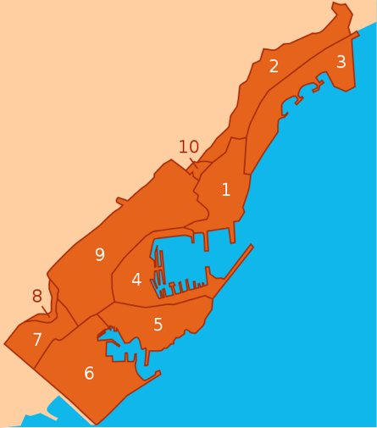
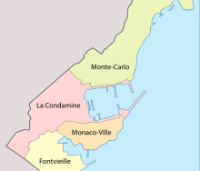
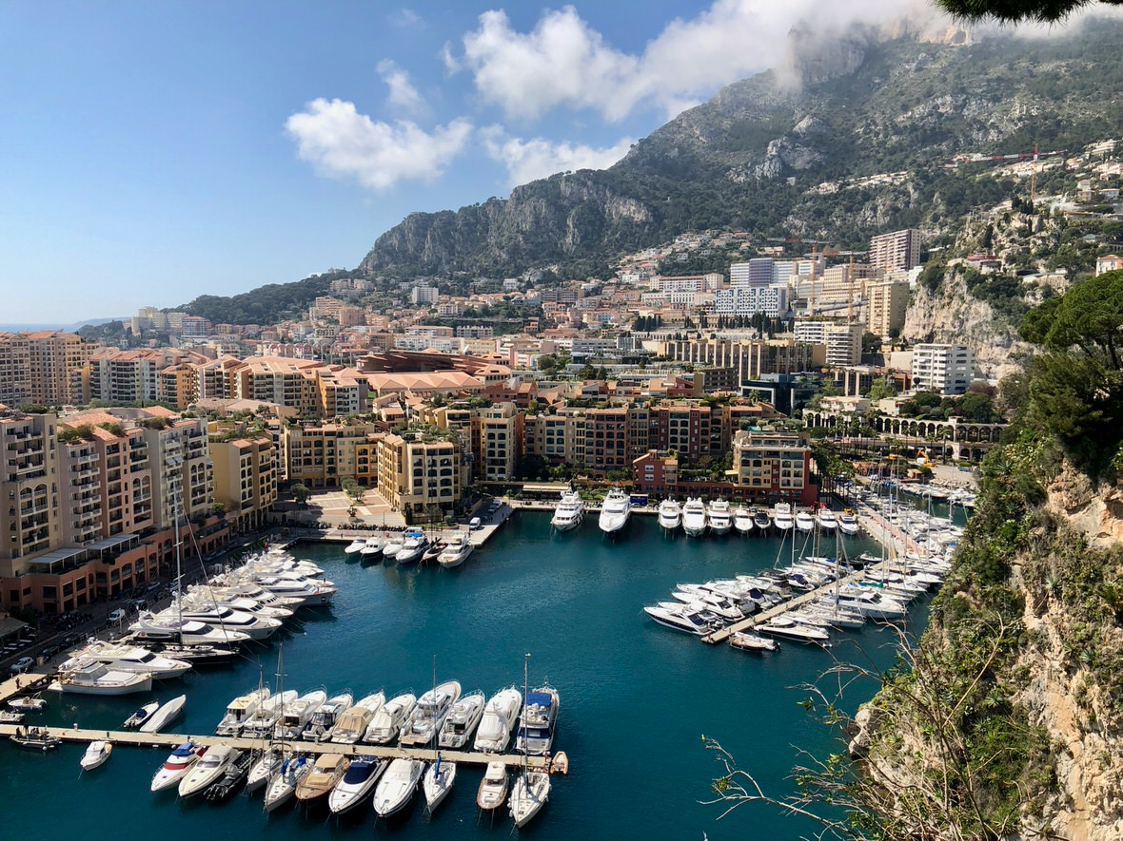
Monaco is split up into 5 quartiers and 10 wards
The 2018 population was 38,682, and with 19,009 people per square km, it is the most densely populated sovereign state in the world.
The country's highest point is 539ft above sea level at the access point to the Patio Palace residential building. The lowest point is the Mediterranean Sea.
Saint-Jean is the longest river, around 190m long, and the biggest lake is Fontvieille, approximately 5,000 square metres

