Slide 1
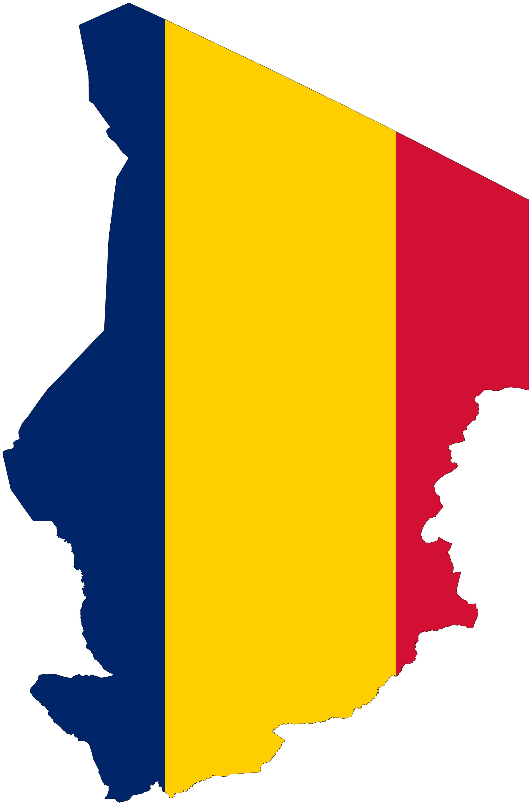
Chad
By Freya, Rebecca, Ciara and Maudie

Slide 2
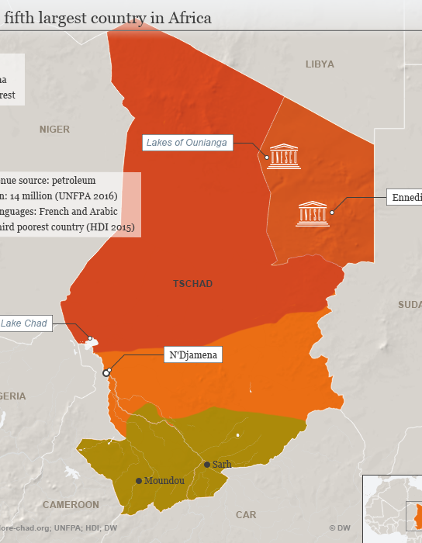
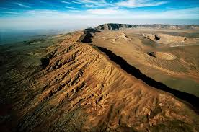
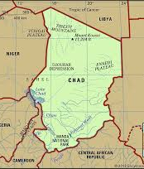
Geographical Information
Chad is sometimes referred to as "dead heart of Africa"
Chad is twice the size of France.
Emi Koussi is the highest peak.
Chad is a hot and tropical country
Chad's capital city is N'Djamena
The population of chad is 15.48 million in 2018

Slide 3
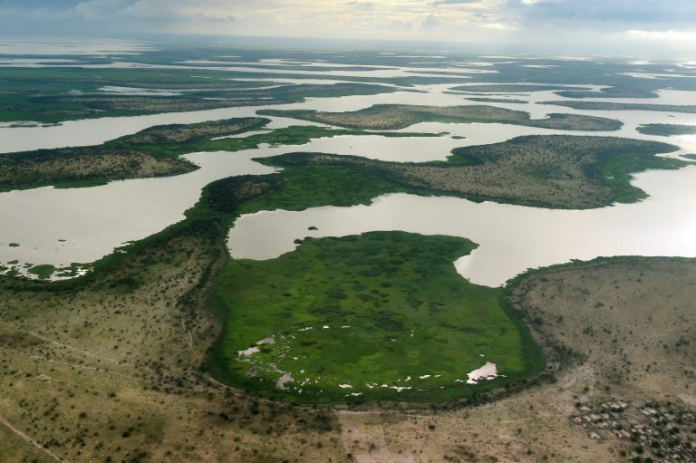
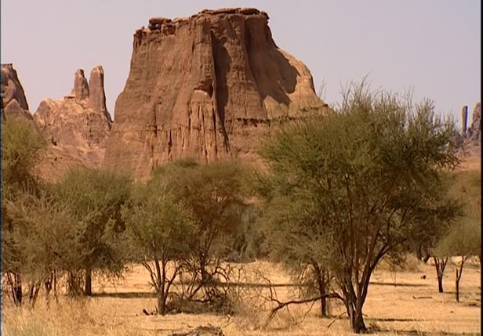
History of Chad
The country is named after Lake Chad.
Gained its independence from France on August 11th, 1960.
The Chadian and Libyan conflict took place between 1978 and 1987.
The country has seen long-lasting conflicts between Muslims and Christians.

Slide 4
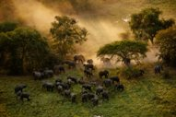
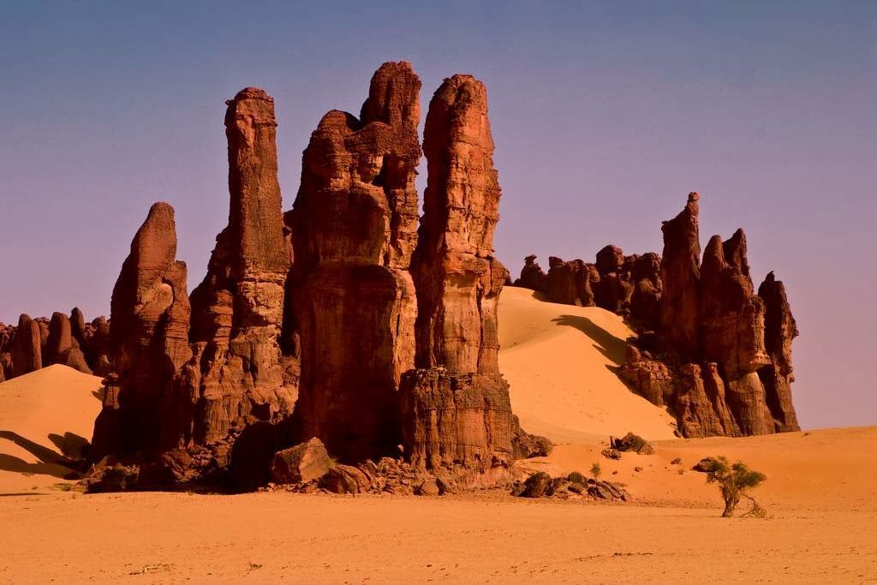
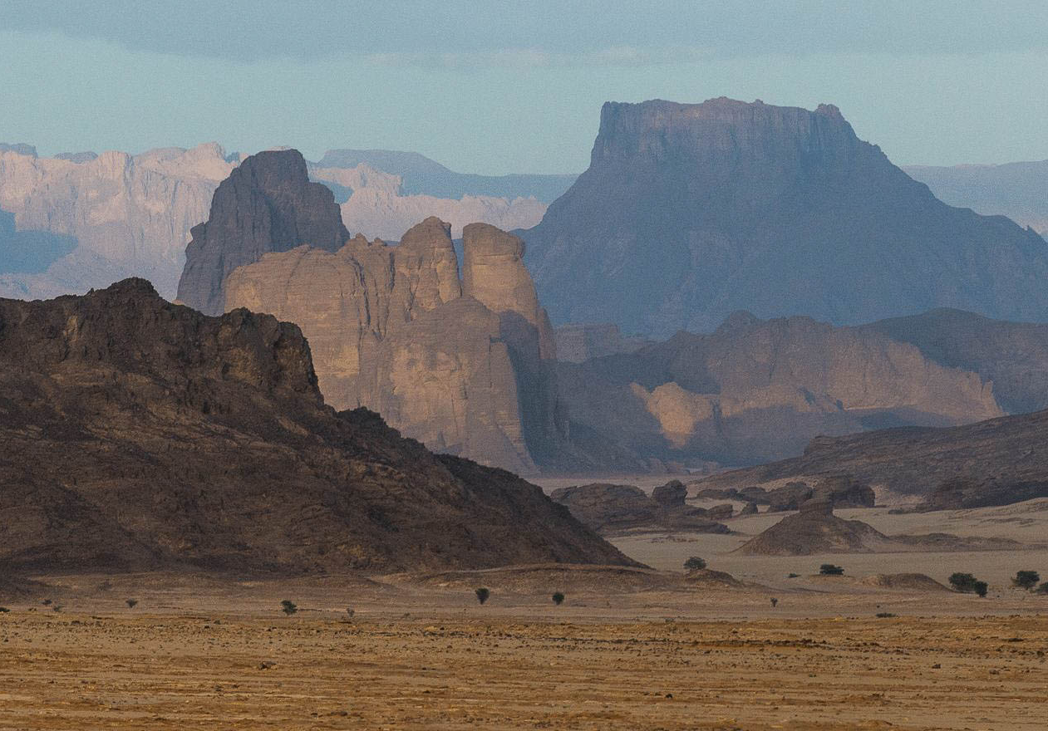
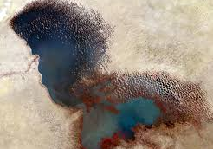
Tourist Information
Low tourism rates – future potential
Attractions in Chad: Lake Chad, Tibesti mountains, Ennedi plateau, Zakouma National Park
Best travel times
Safety advice
Recent tourist advice

Slide 5
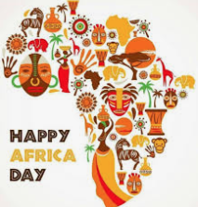
Traditions
Many different special events
Muslim celebrations
Independence Day
Liberation of Africa

Slide 6
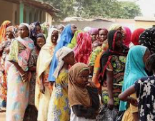
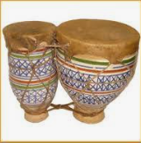
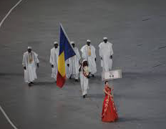
Culture
National Dish – Peanut and Squash Stew
Sports
Music
Clothing

Slide 7
Thank You For Listening
Any Questions?

