Slide 1
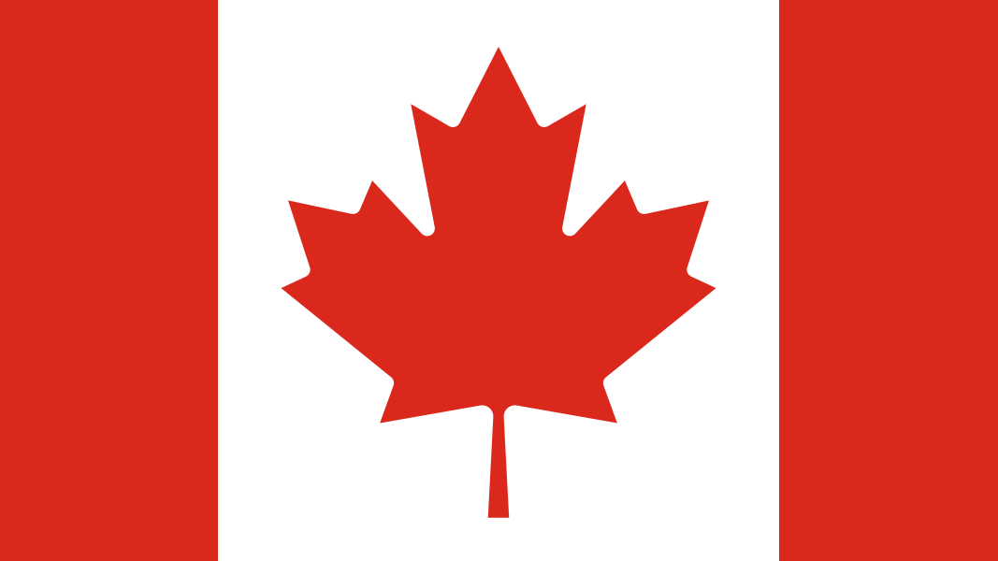
French Speaking Canada

Slide 2
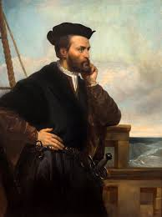
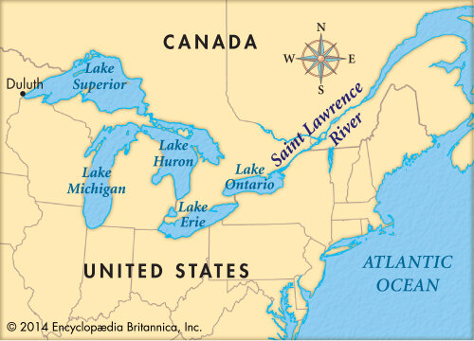
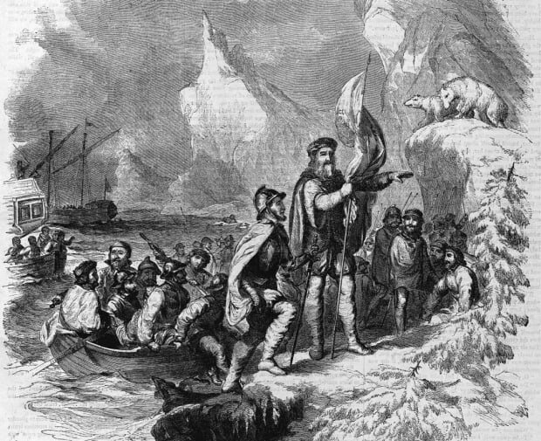
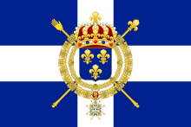
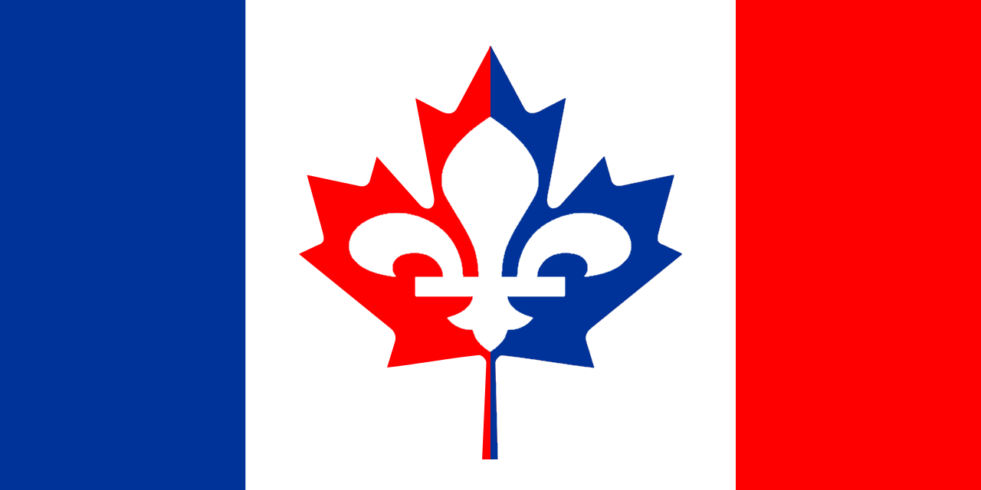
History – Why French is spoken there?
Saint Lawrence River.
Jacques Cartier
The French colonists arriving in Canada.
The French-Canadian flag
The flag of New France

Slide 3
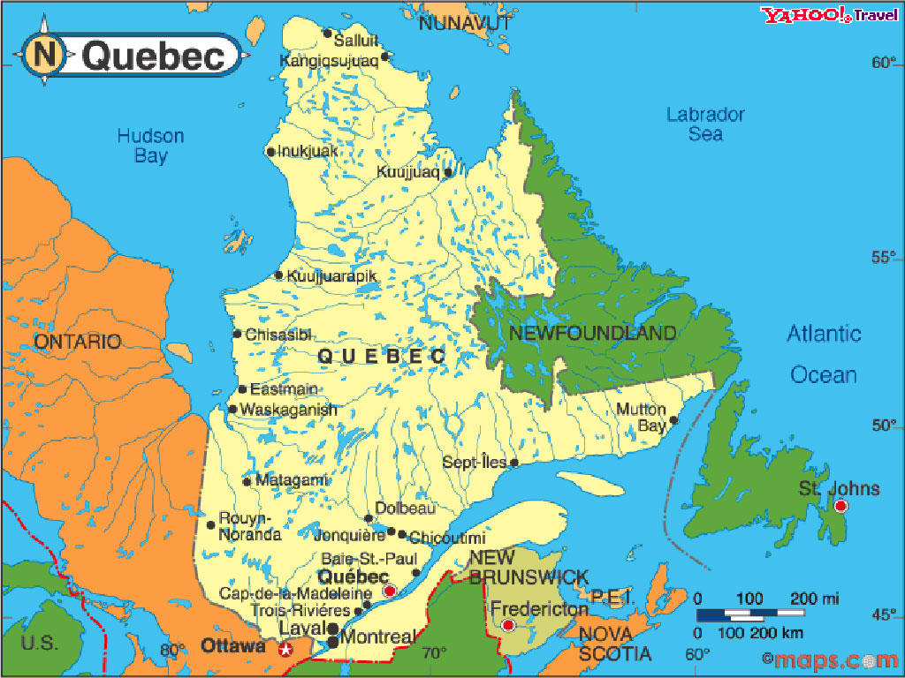
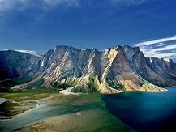
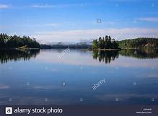
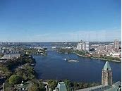
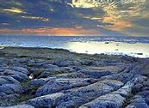
Geography of Québec
Québec
Capital: Québec City
Population: 8.485 million
Area: 1,542,056
Torngat Mountains
Lake Kempt
Ottawa
River
Canadian Shield

Slide 4
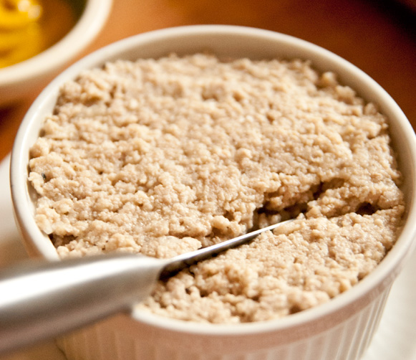
Culture and Traditions
Culture
Canadian culture is a mix of British, French and American influences.
One of the main places that speak French in Canada is Quebec.
People from Quebec are known for their “Joie de vivre”, and for their strong French accents.
Food
Poutine is a favored French-Canadian dish. It consist of crispy fries, cheese and thick rich gravy. Sometimes pork is added to it.
Cretons is another popular French-Canadian dish. It is a meat spread made from ground pork and seasoned with many spices. It is usually spread on toast.

Slide 5
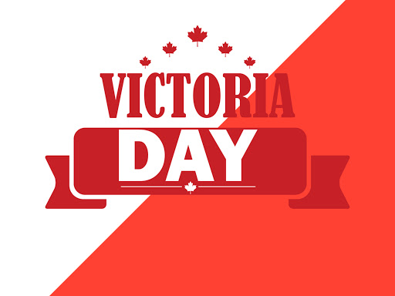
Culture and Traditions
Sport
Ice hockey is an immensely popular sport which is played all over Canada. It is the county’s national sport
Music
When the French first came to Canada, they brought instruments like the organs and sheet music
Traditions
Dollard Day is a celebration in Canada which honors the British Queen Victoria, it is always on the Monday proceeding May 25th.

Slide 6
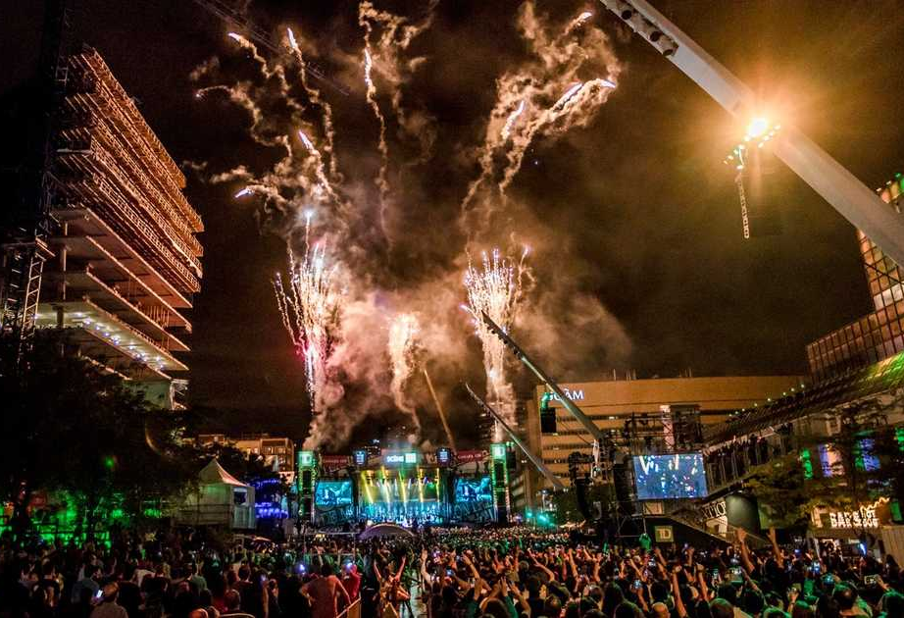
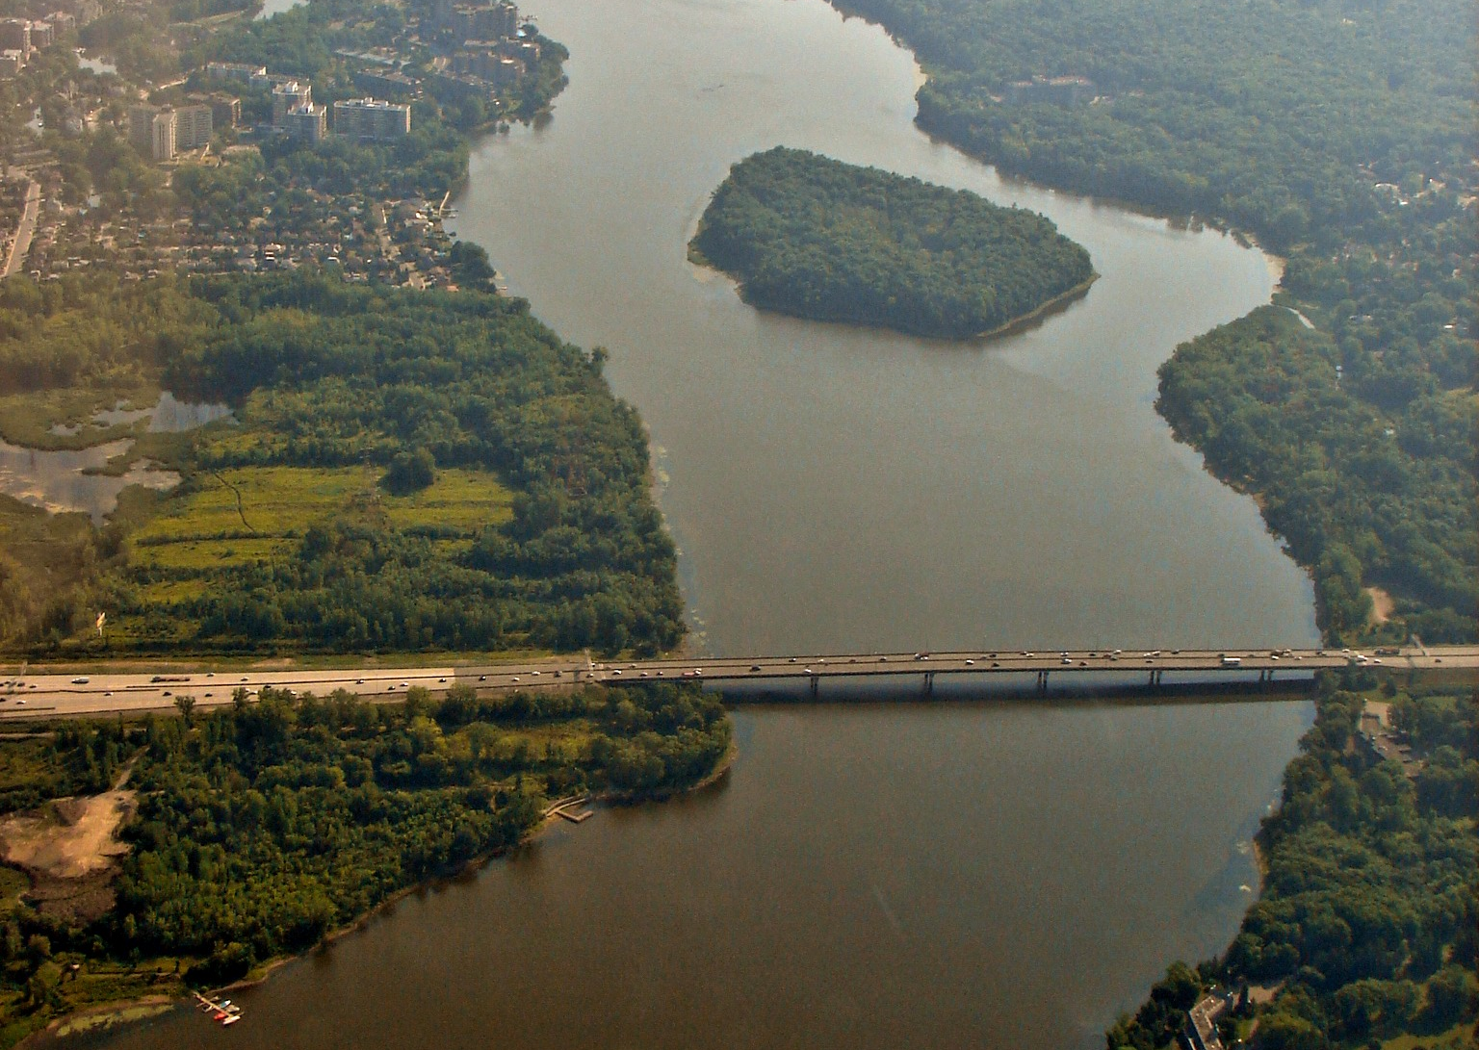
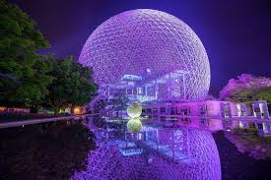
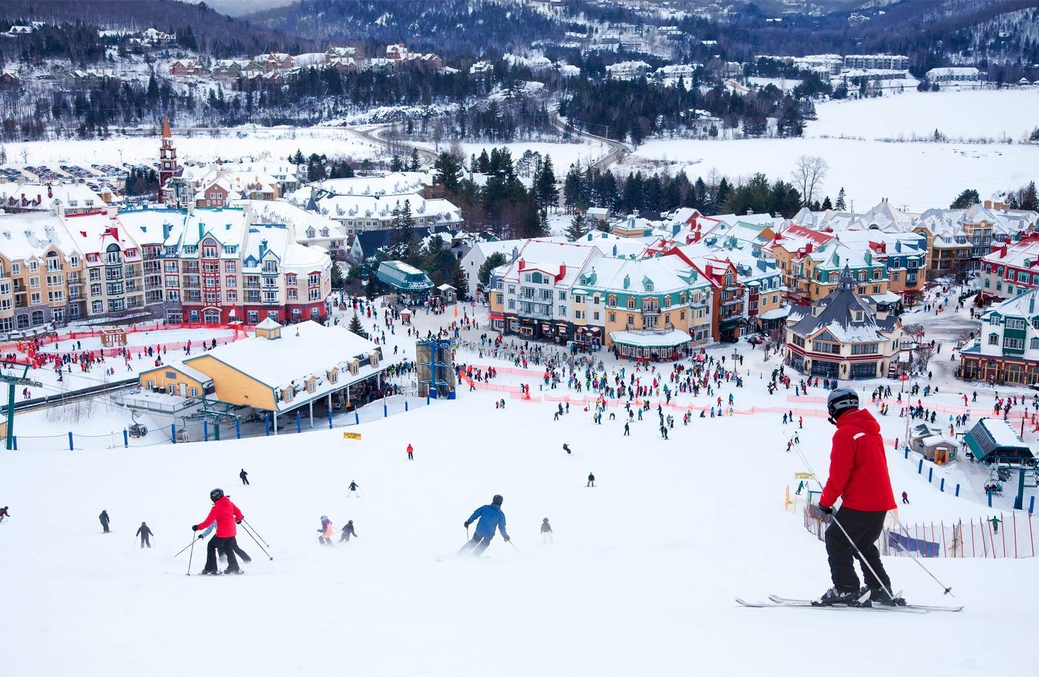
Tourist information.
1. Rivières des prairies is a river North-West of Quebec.
2. The Biospehere ( Environmental museum)
3.Montreal international jazz festival. 11 days from end of June to the beginning of July.
4. Laurentian mountain range.

