Slide 1
Cameroon
BY Megan, Amelie, Duncan and Eilidh

Slide 2
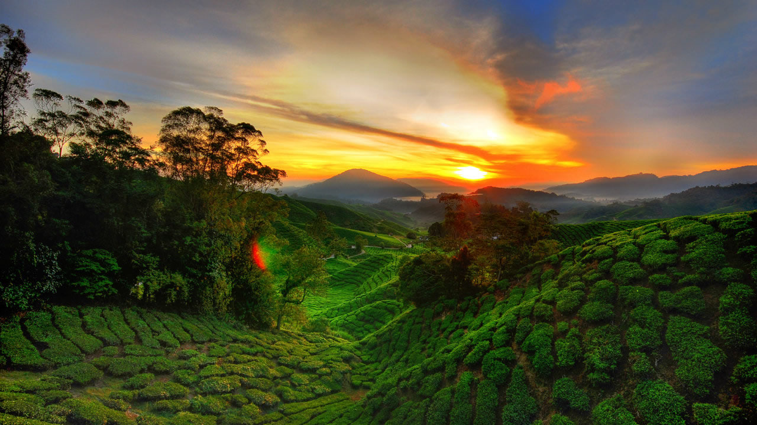
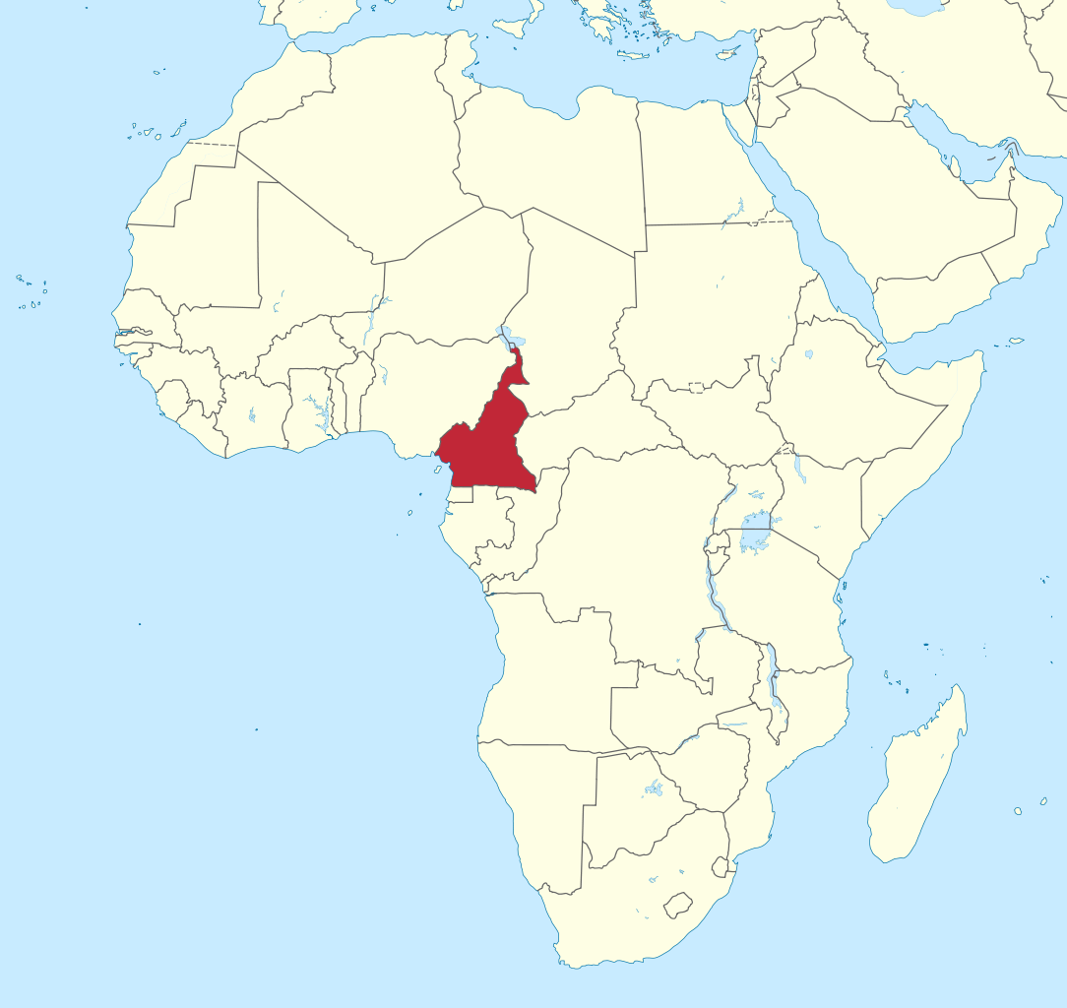
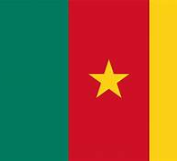
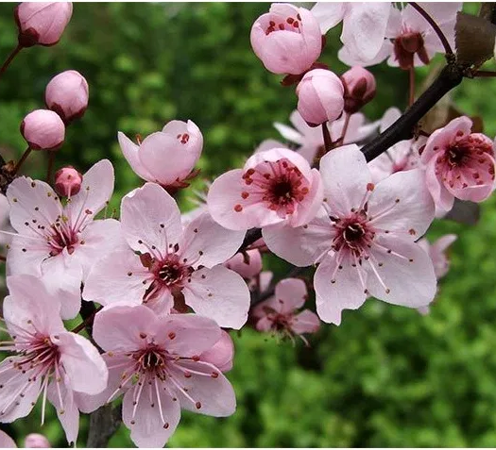
cameroon
The Capital is Yaoundé
The national flower is the Red Stinkwood.
Paul Biya oversees the country.
The flag is green red and yellow
Notes:
Yaoundé has been the capital of Cameroon since 1922 and has a population of 640,000
Red Stinkwood is a montane forest species, its scientific name is Prunus Africana.
He has overseen Cameroon since 1982, He is married to Chantel Biya. He is 87.
The flag was adapted from previous flags in 1975 after Cameroon became a unitary state. The green stands the green of the savannas, the red shows unity and the yellow stands for the sun.

Slide 3
Introduction
The Capital is Yaoundé
The national flower is the Red Stinkwood.
Paul Biya oversees the country.
The flag is green red and yellow
Notes:
Yaoundé has been the capital of Cameroon since 1922 and has a population of 640,000
Red Stinkwood is a montane forest species, its scientific name is Prunus Africana.
He has overseen Cameroon since 1982, He is married to Chantel Biya. He is 87.
The flag was adapted from previous flags in 1975 after Cameroon became a unitary state. The green stands the green of the savannas, the red shows unity and the yellow stands for the sun.

Slide 4
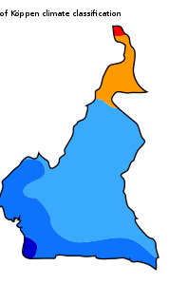
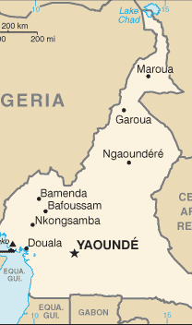
GEOGRAPHICAL INFORMATION
Cameroon is in central Africa, over half of the perimeter bordered by Nigeria.
Has the highest mountain in West Africa
It is known for having five major geographical zones.

Slide 5
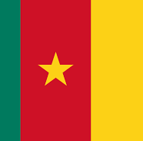
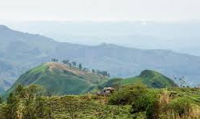
History
Cameroon was first colonised in 1884
Official languages are English and French
Cameroon was given to France and Britain after the second world was.
The earliest inhabitants were most likely the Baka

Slide 6
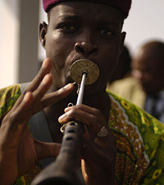
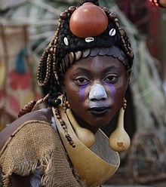
CULTURE AND TRADITIONS
Religion
Holidays
Politics
Languages
Culture
Notes:
Cameroon culture includes of lots of religions including Christianity about 69%, Islam about 21%, and many other indigenous religions. The citizens of Cameroon are entitled to freedom of religion, Therefore, citizens are free to practice any religion they choose, without harassment or forceful conversion.
Religious holidays in Cameroon include:
Christian: Good Friday, Easter Sunday, Easter Monday, Pentecost, Ascension Thursday and Palm Sunday
Muslim: Eid ul-Fitr, Eid ul-Adha and Ramadan
Since an amendment was added to the Cameroon Constitution in 1992, Cameroon has been a multi-party state, which means there are multiple parties that have the ability to gain power over the government.
Cameroon estimated 300+ languages. Their official languages are French and English. The other languages include the Akoose language, the Fula language and many more.
Partly through the influence of colonialism, there is a national culture, which is established through public institutions such as school, the multiparty political system, shared history of colonialism and a national love of football

Slide 7
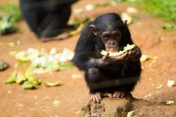
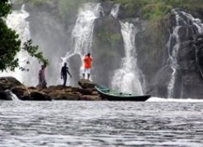
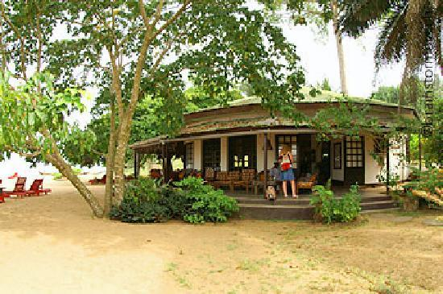
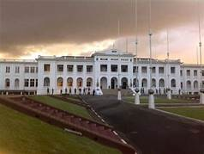
Tourist information
In Cameroon there is a range of wildlife parks, museums and many waterfalls and nature hikes
There are a huge range of places to stay in Cameroon, such as hotels and private villas.
There are a lot of options for restaurants in Cameroon, they do African, French and American cuisines.
Notes:
One Nature park is Mefou National park, located in the South West. It hold more than 300 rare and edangered primates.
One Hotel is the Hotel Ilomba, It is just outside Kribi, a beachside town. Kribi is located just short drive to Chutes de la Lobe, there is also a canoe ride that can take you right up to the falls.
One of the most popular resterauntes is in Yaounde, called Le Safoutier, they mainly focus on French and African cuisine. In Yaounde there are a lot of museams and art galerys such as The National Museum of Yaonde and La Safoutier is a short walk away.

Slide 8
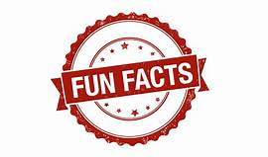
Notes:
It is the sixth biggest producer of Coco Beans
There are 230 spoken languages
They still have pirates
They have many hot springs thought the country
The average life expectancy for a man is 56 and a woman is 58.
In 1990, Cameroon became the first African country to enter the quarter-final of the FIFA World Cup
Cameroon is not only one of the wettest countries in the world it is also blessed with extremely fertile soil.
More than 30% of the population earns less $1.25.

Slide 9
Thank you for listening

