Slide 1
Nursing
Nicola Baker Brown
Senior Theatre Practitioner
Canniesburn Burns and Plastic Surgery Unit
Glasgow Royal Infirmary

Slide 2
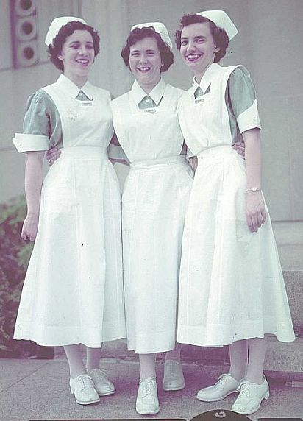

Slide 3
My Qualifications
HNC Healthcare – Falkirk College
Bsc in Adult Nursing – University of Stirling
Post Graduate Certificate in Perioperative Practice and Anaesthetics – Glasgow Caledonian University
Post Graduate Diploma in Burns and Plastic Surgery – University of Glasgow

Slide 4
Burns and Plastic Surgery Unit
Ward Nurse
Scrub Nurse
Anaesthetic Nurse
Dressings Clinic Nurse
Nurse Practitioner – Minor Surgery
Burns Specialist Nurse
Burns Outreach Nurse
Pre Operative Admission Nurse
Tattoo Nurses
Skin Cancer Specialist Nurse
Breast Team Nurse
Out patients Nurse
Laser Nurse

Slide 5
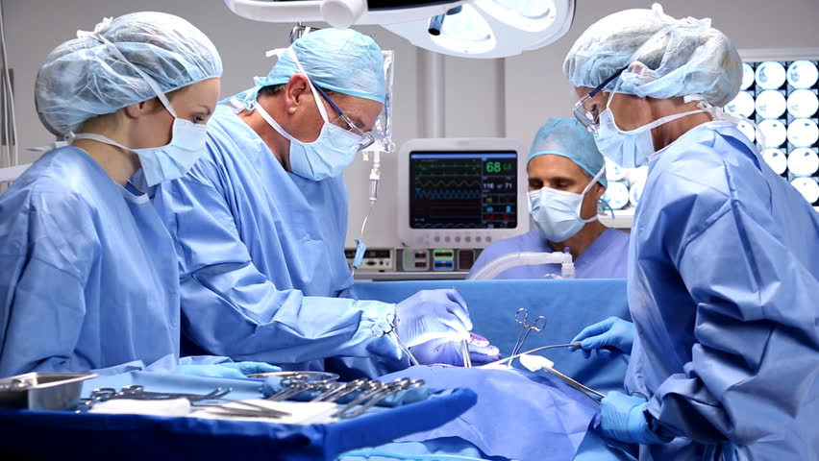

Slide 6
Burns and Plastic Surgery Unit
Burns
Trauma
Hand Surgery
Micro surgery
Lower Limb Reconstruction
Laser
Breast Reconstruction
Skin Cancer
General Plastic Surgery
Gyn Reconstruction
Ortho-Plastic Limb Reconstruction
Sarcoma Team
Head and Neck Surgery
Facial re-animation
Nerve Injuries
Cleft and Craniofacial reconstruction

Slide 7
How to apply
The rough guide

Slide 8
Entry Requirements
SQA Higher : BBBB
One higher must be in Chemistry, Physics, Biology or Maths
OR
HNC/HND
Bs in graded units

Slide 9
University
Bachelor of Nursing– 3 years with Honours 4 years
University of Stirling
Glasgow Caledonian University
University of Glasgow
Edinburgh Napier University
Queen Margaret University Edinburgh
University of Edinburgh
University of Highlands and Islands
University of West of Scotland
Abertay University Dundee
University of Dundee
Robert Gordon University Aberdeen

Slide 10
Which Degree?
Adult Nursing
Mental Health Nursing
Nursing Studies (Children and Young People)
Nursing Studies (Learning Disability)
Midwifery

Slide 11
Application Process
Application form
Compulsory Applicants Day
Disclosure Scotland check
Occupational Health Check

Slide 12
Fees
Scottish and EU students – fees paid by the Scottish Government
Students from the rest of UK - £9250
Non EU students - £15,600

Slide 13
Course Content
Lectures
Practice Placements (7-10 week placements every semester)
Practice learning
Key subject areas studied include health, social and behavioural sciences, communication, law and ethics and essential clinical skills. Courses include topics common to all areas of generic nursing and those specific to Adult or Mental Health nursing. This means that some classes will be shared whilst others will concentrate on your chosen field.

Slide 14
Practice Learning and Student Support
Practice learning forms an integral aspect of the course. A diverse range of practice placements are available, from community settings and care homes to acute hospital wards and specialist areas. Students may work both day and night shifts to coincide with the patterns of the area and their allocated practice mentor.
Each student is allocated a personal tutor who will be a source of guidance, information and support for the duration of their time on the course. Whilst undertaking practice learning experiences, students are allocated a practice mentor who will facilitate and support learning in practice.

Slide 15
Areas of Nursing
Medical wards
Surgical wards
Geriatrics
Paediatrics
Theatres
Clinics
Community
Accident and Emergency
Intensive Care
High Dependency Unit
Schools
Practitioner posts
Specialist posts

Slide 16
Post Graduate Study
So many choices

Slide 17
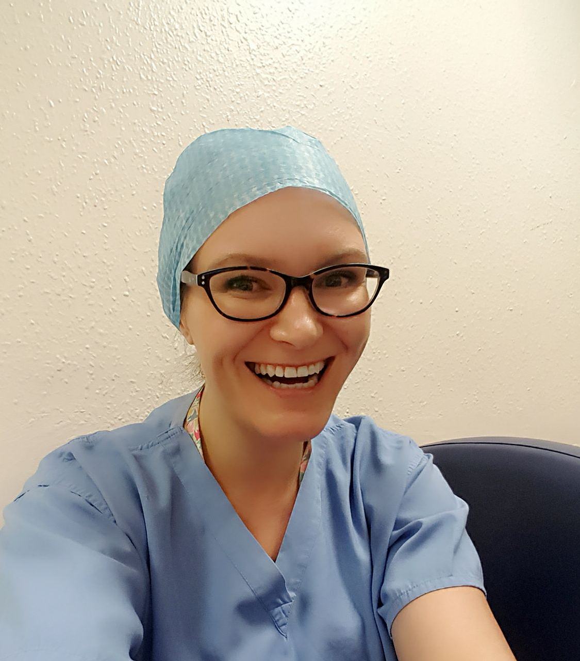
Good Luck

